Slide 1






Slide 2
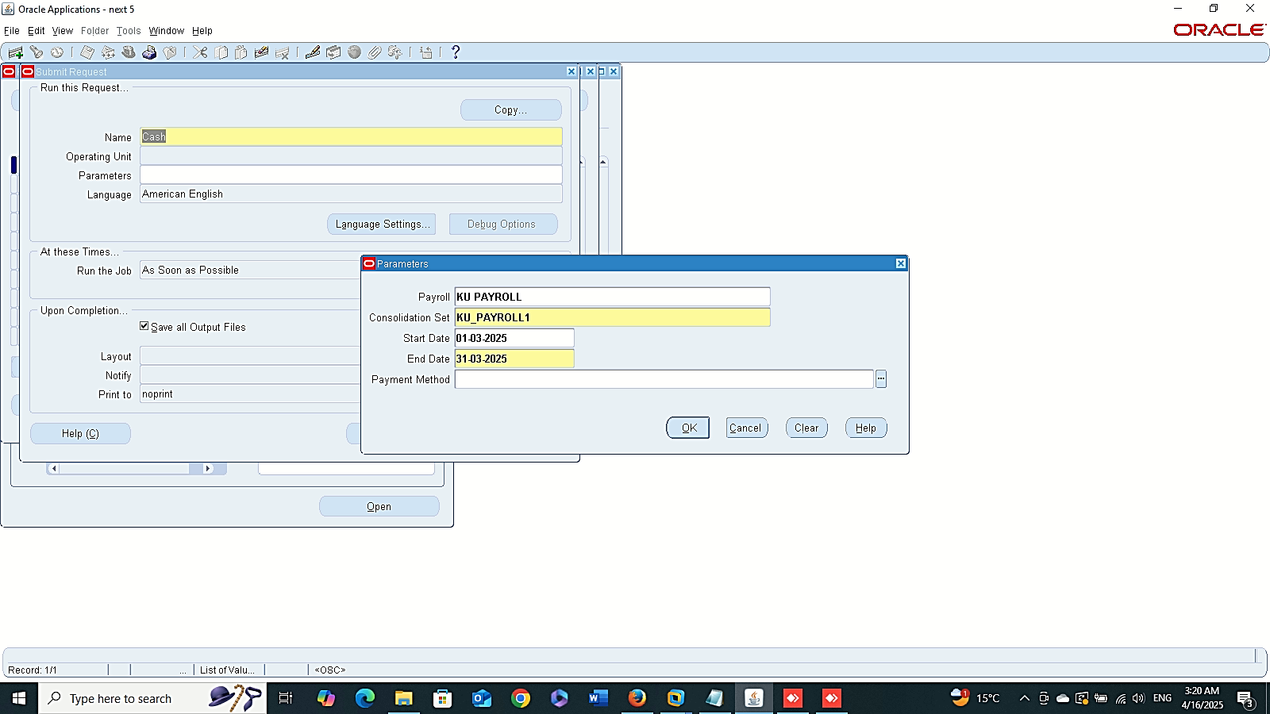
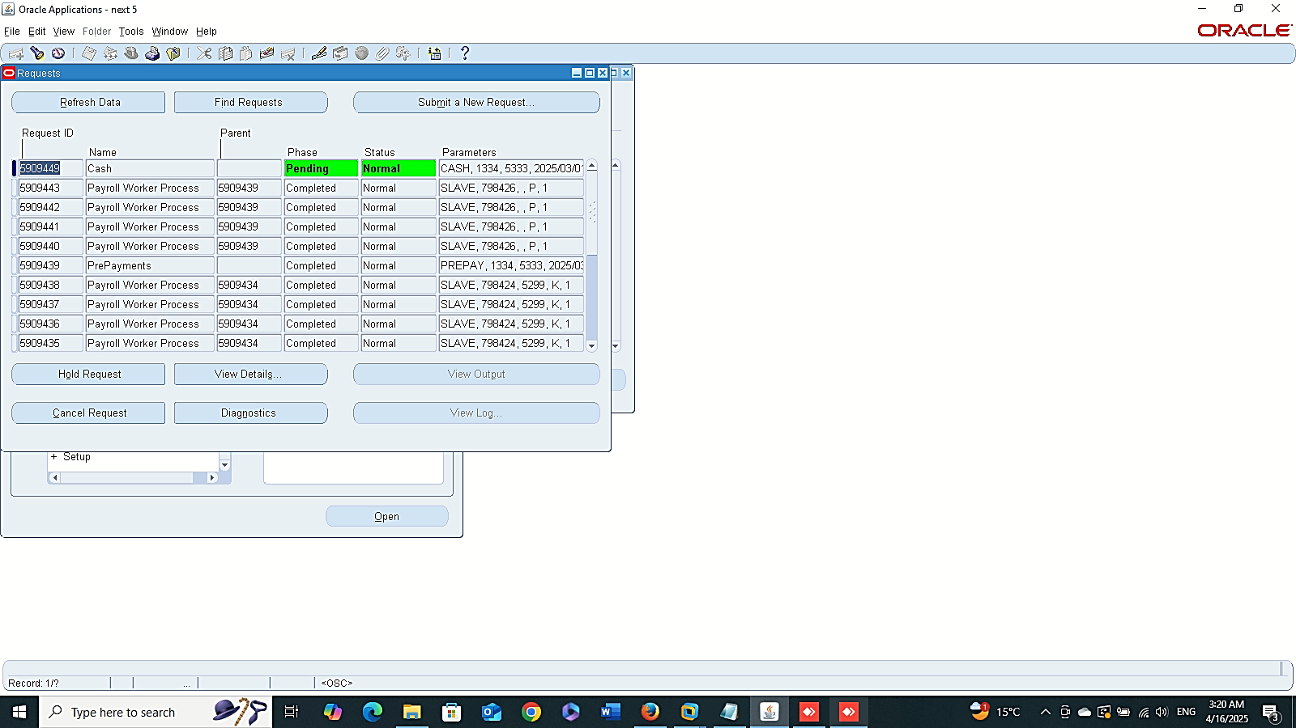
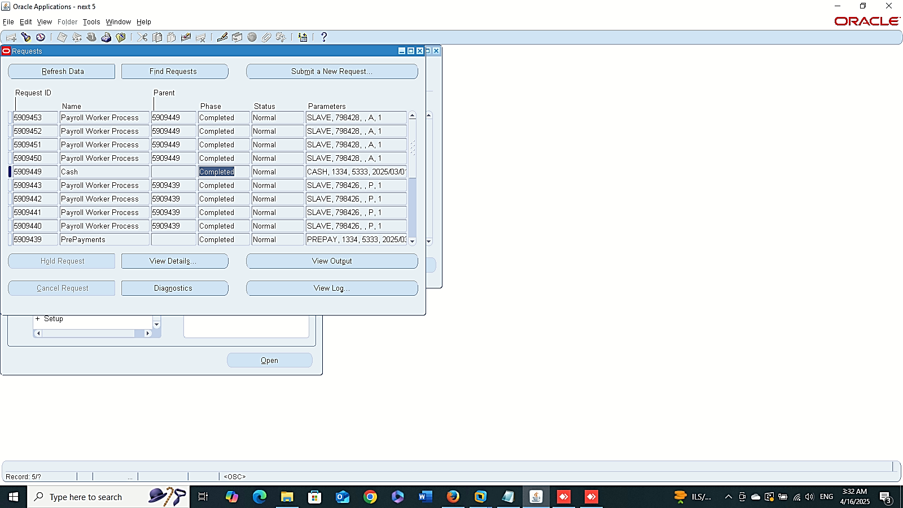
Finance Management (Payroll)
Cash Requests
Global HRMS MANAGER > VIEW > REQUESTS > SUBMIT A NEW REQUIST > CASH

Slide 3
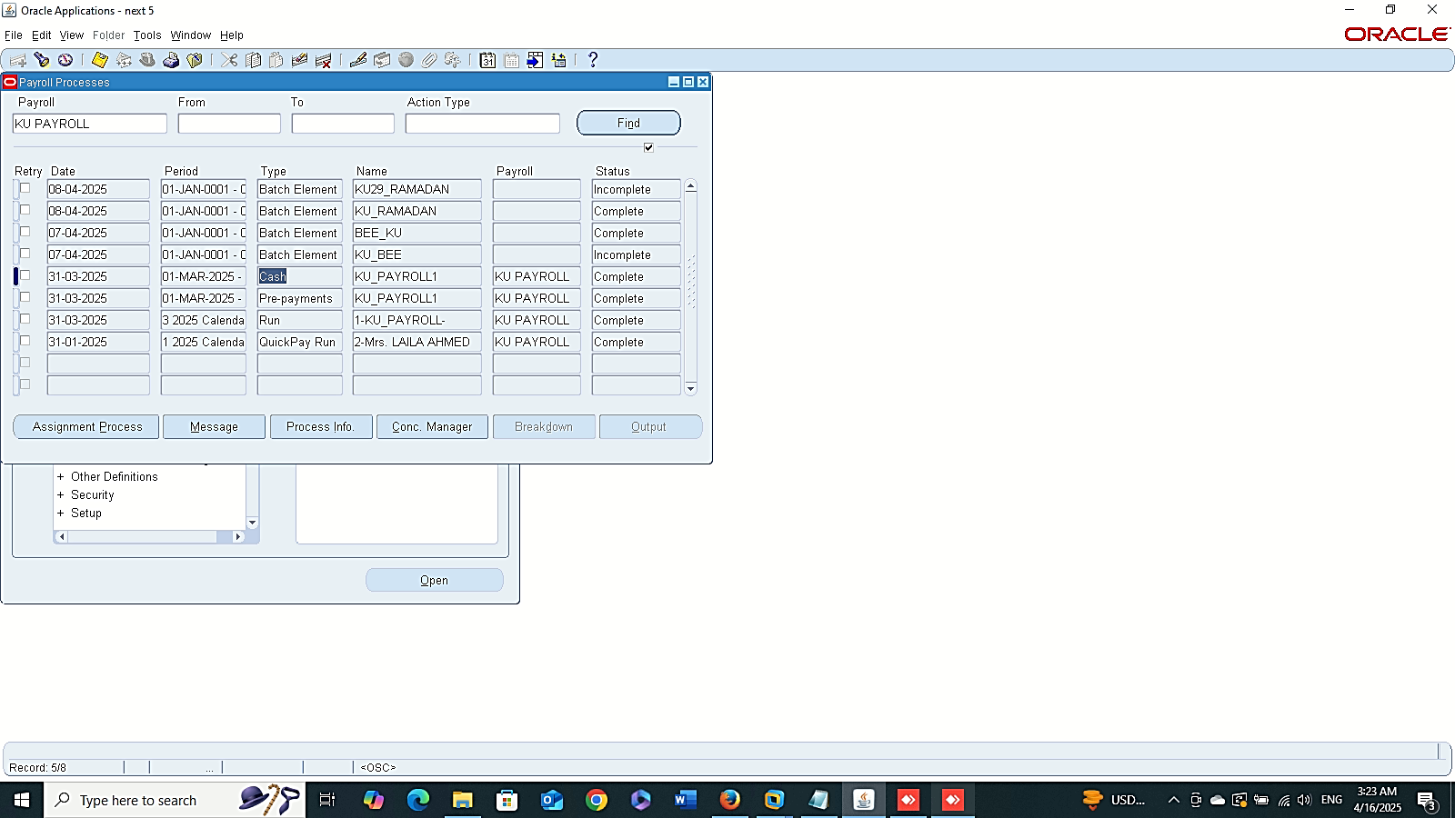
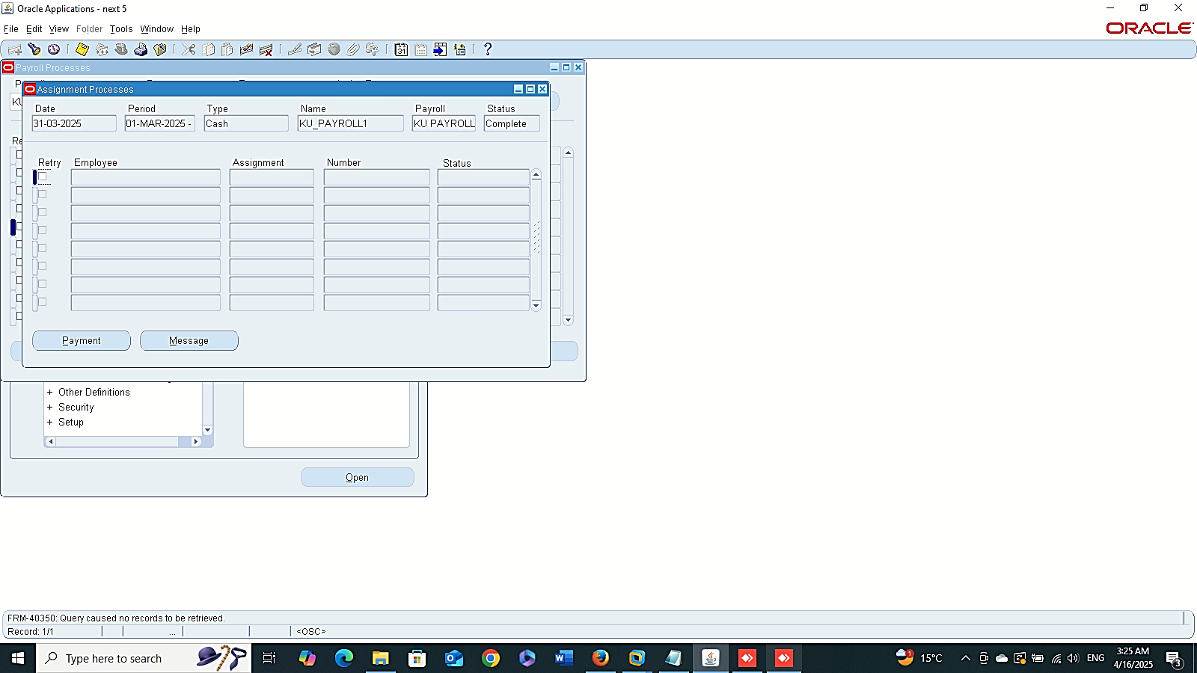
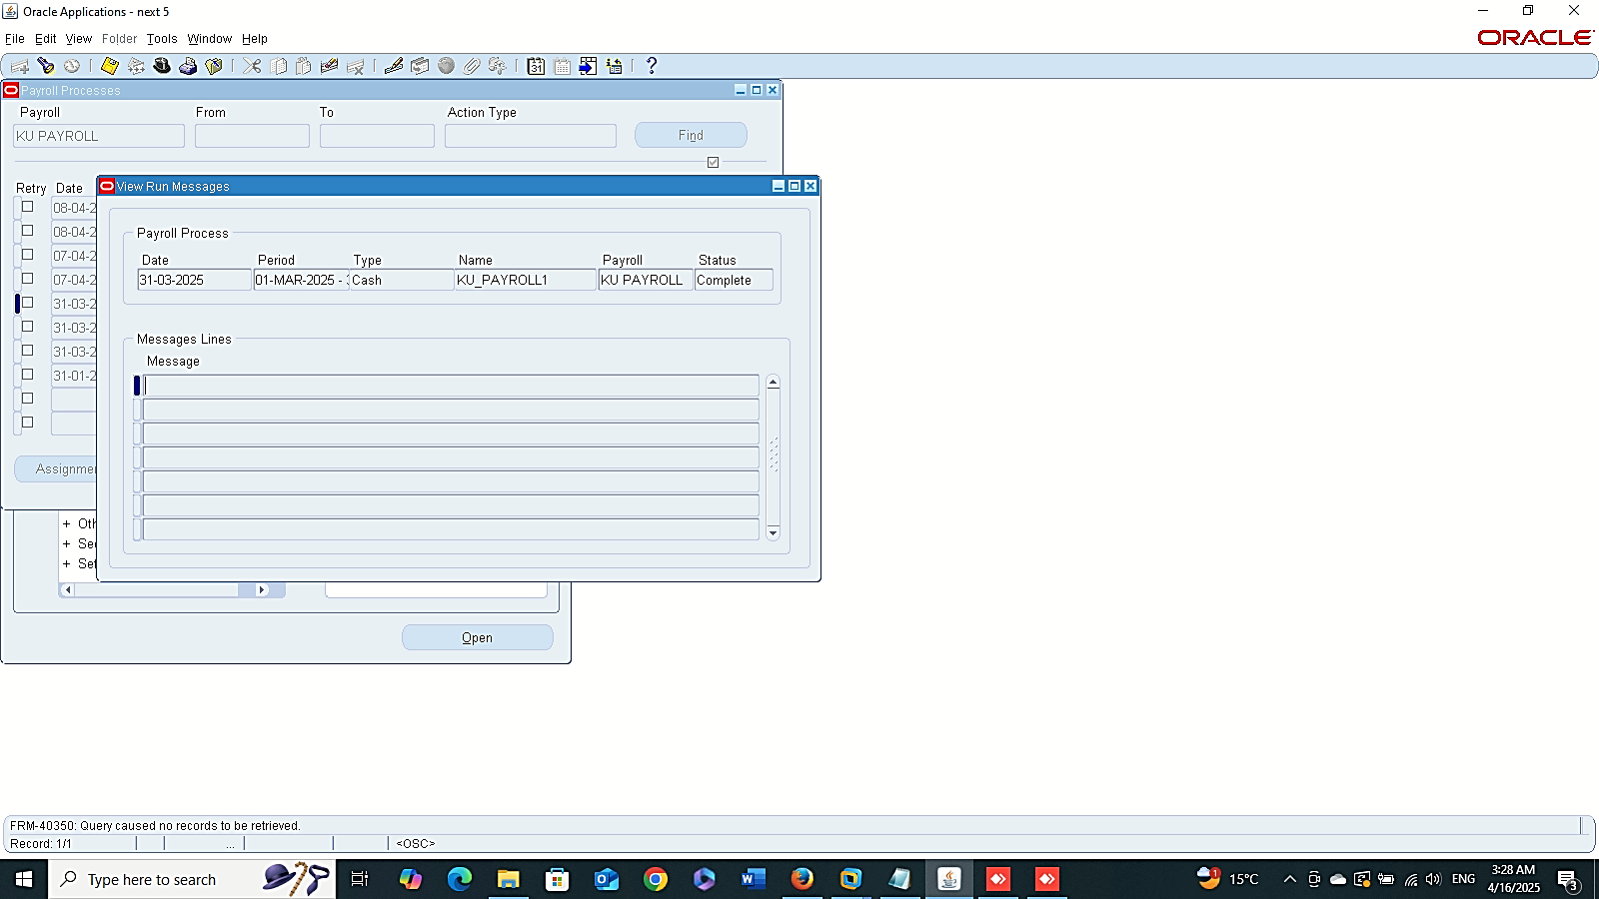
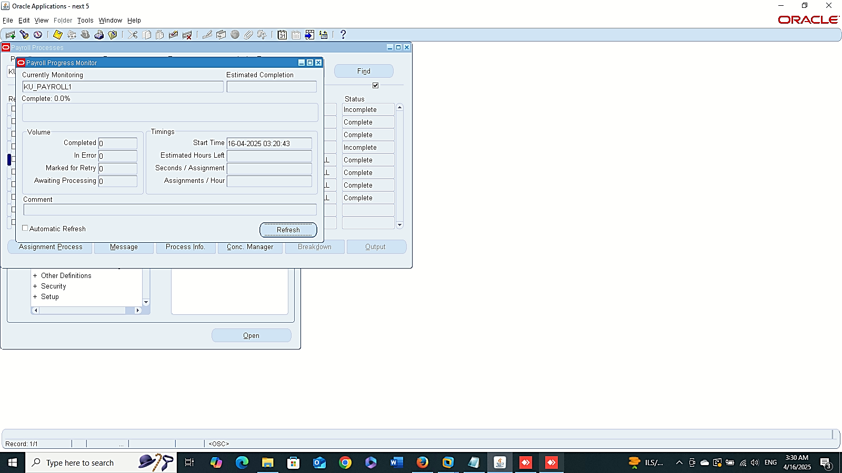
Assignment Process
Finance Management (Payroll)
Payroll Process Results:
GLOBAL HRMS MANAGER > VIEW > LISTS > PAYROLL PROCESS RESULTS
Message
Process Info

Slide 4
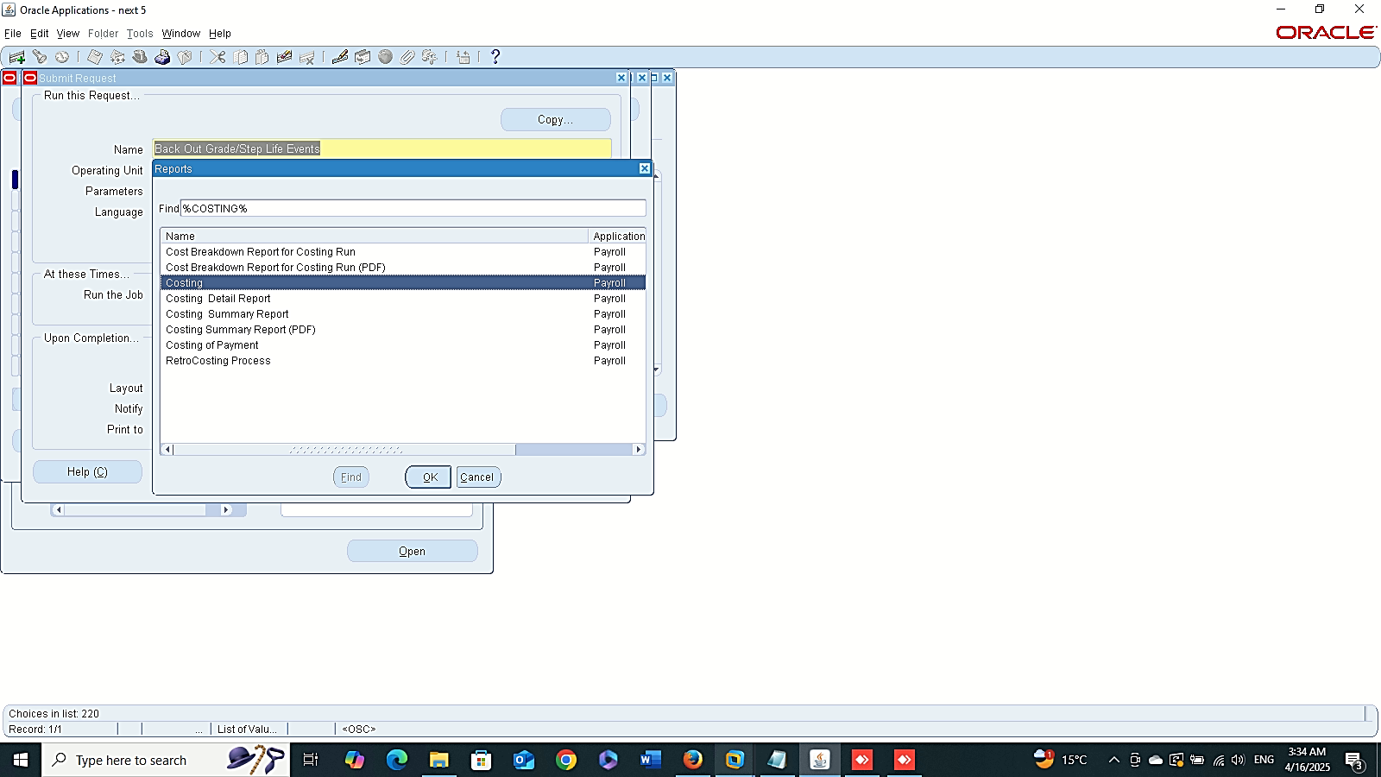
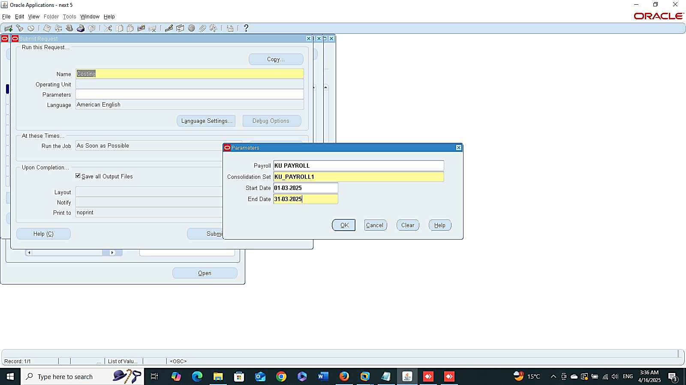
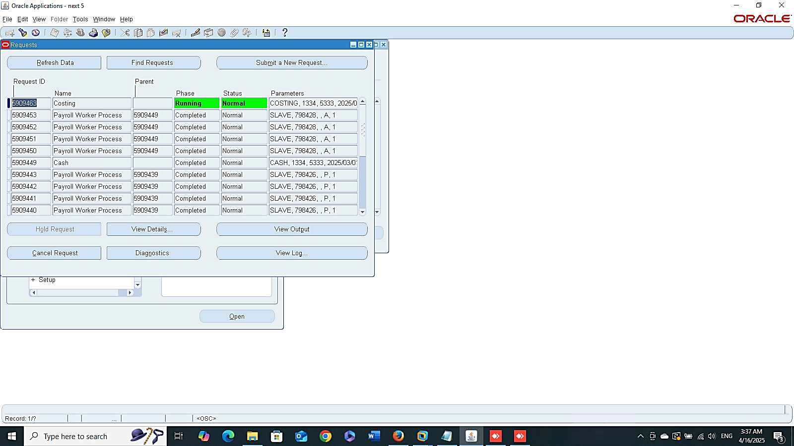
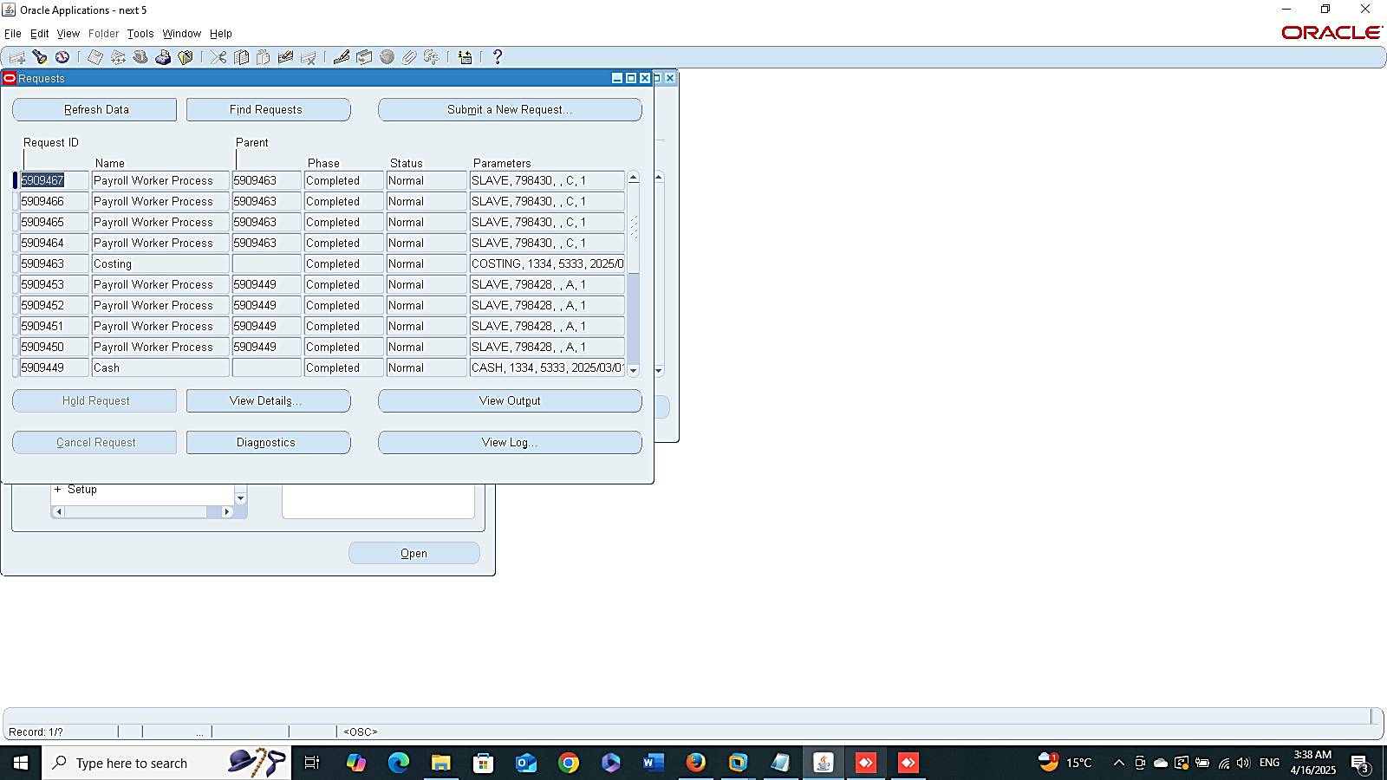
Finance Management (Payroll)
Prepayment Requestsv
Costing Requests:
Global HRMS MANAGER > VIEW > REQUESTS > SUBMIT A NEW REQUIST > COSTING

Slide 5
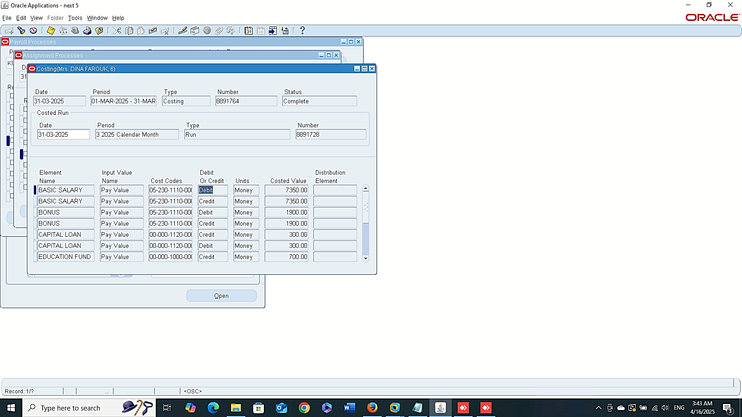
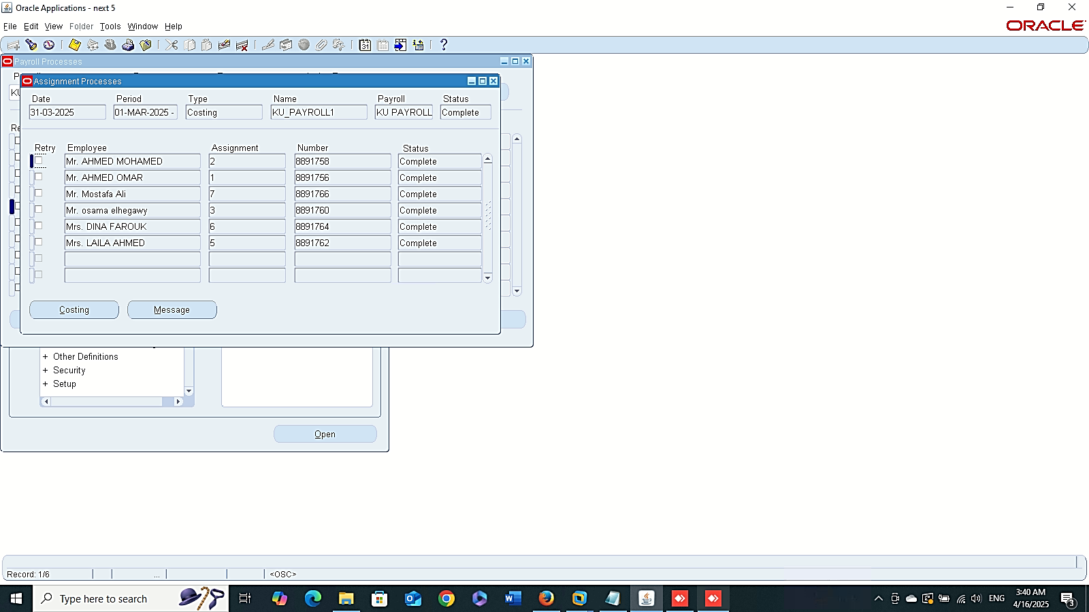
Assignment Process
Finance Management (Payroll)
Payroll Process Results:
GLOBAL HRMS MANAGER > VIEW > LISTS > PAYROLL PROCESS RESULTS
Costing

Slide 6
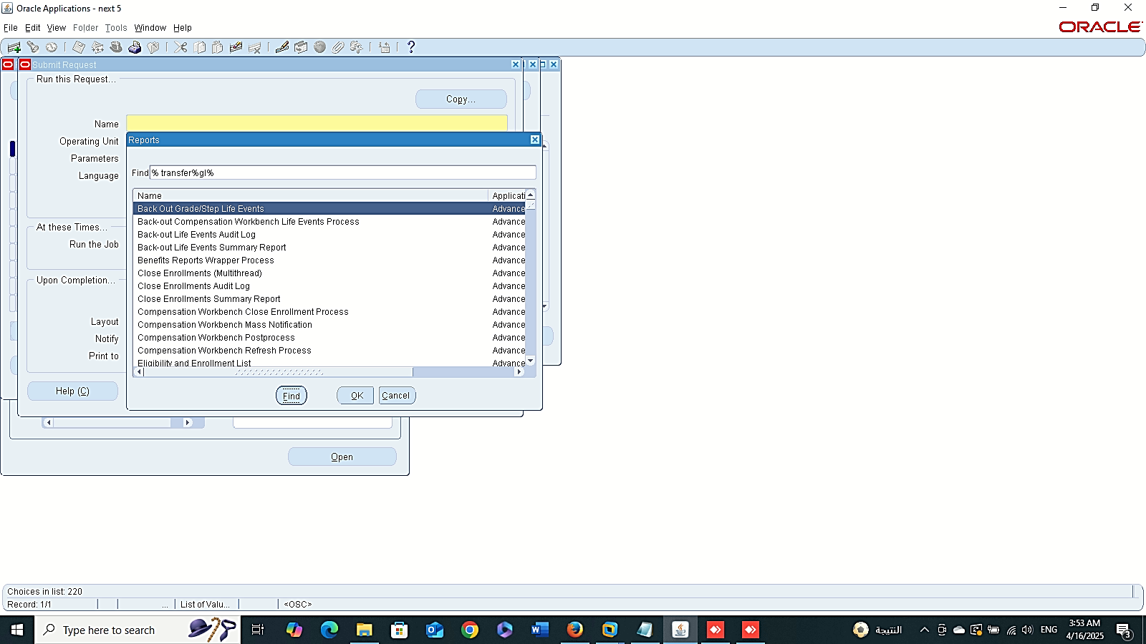
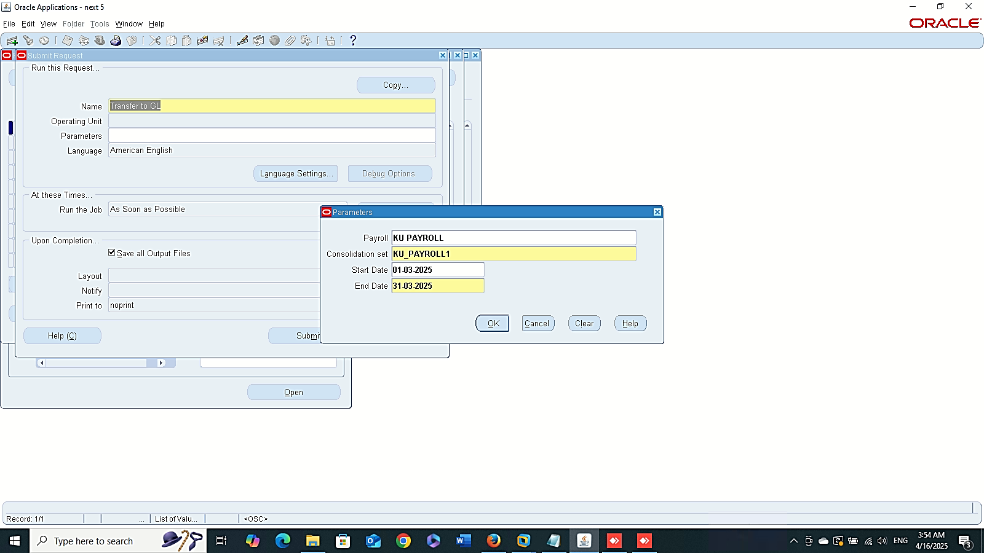
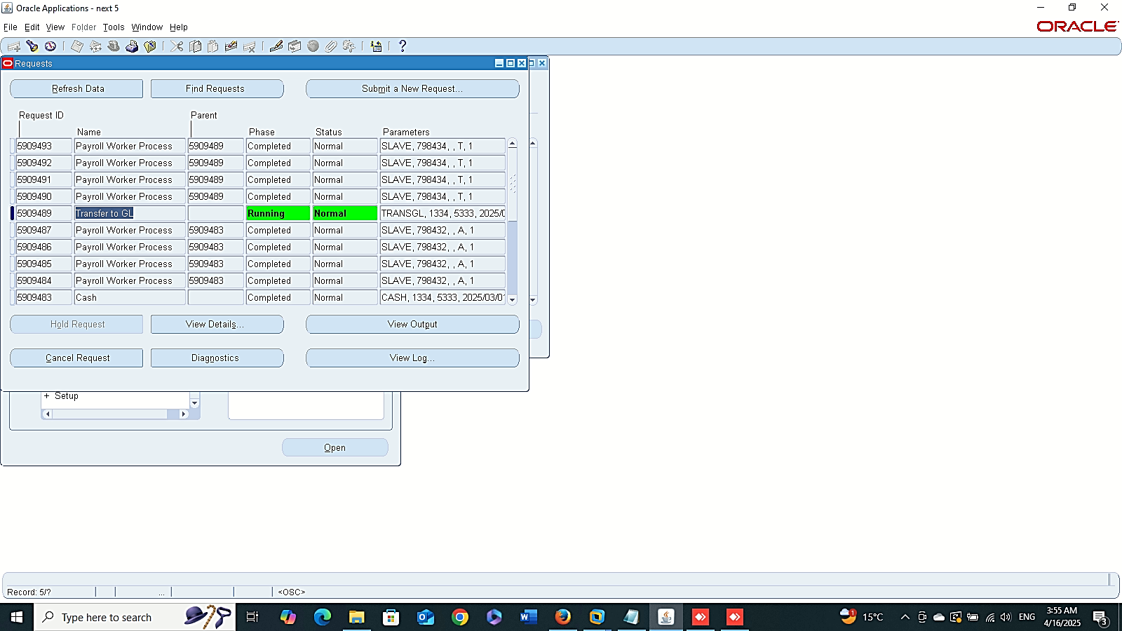
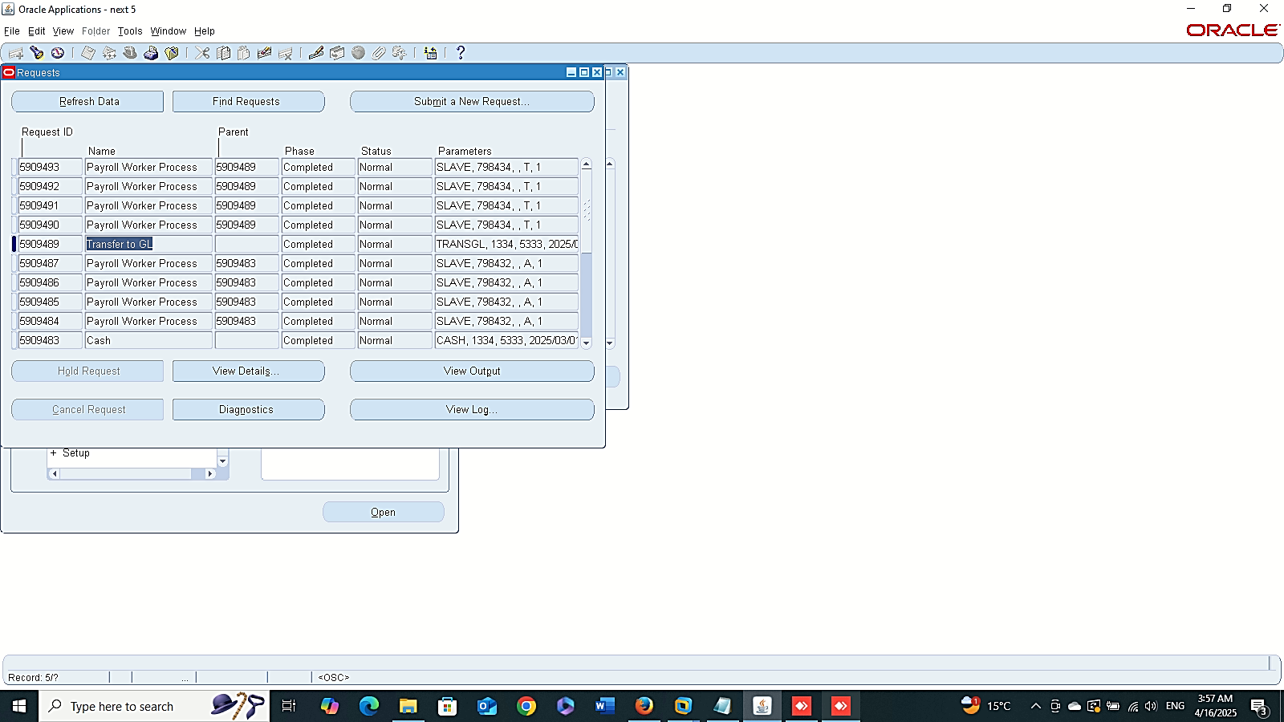
Finance Management (Payroll)
Prepayment Requestsv
Transfer To GL Requests:
Global HRMS MANAGER > VIEW > REQUESTS > SUBMIT A NEW REQUIST > TANSFER GL

Slide 7
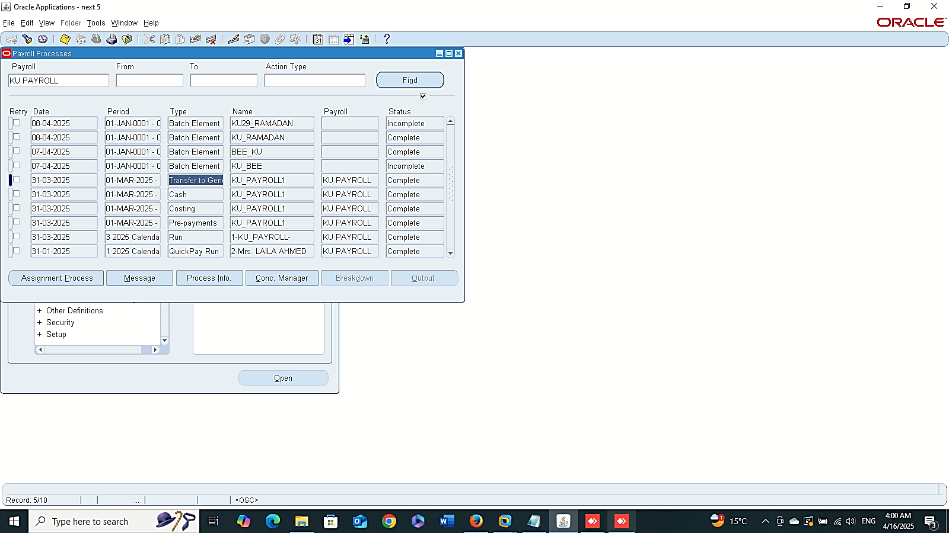

Finance Management (Payroll)
Payroll Process Results:
GLOBAL HRMS MANAGER > VIEW > LISTS > PAYROLL PROCESS RESULTS
Assignment Process

Slide 8
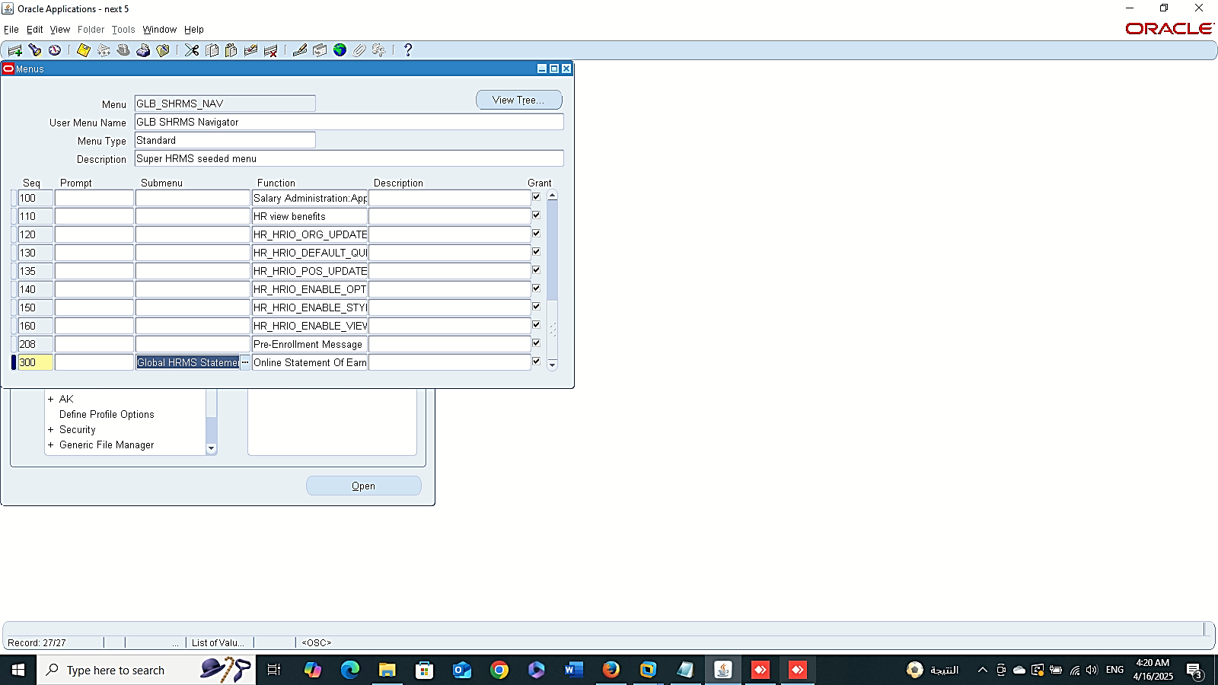
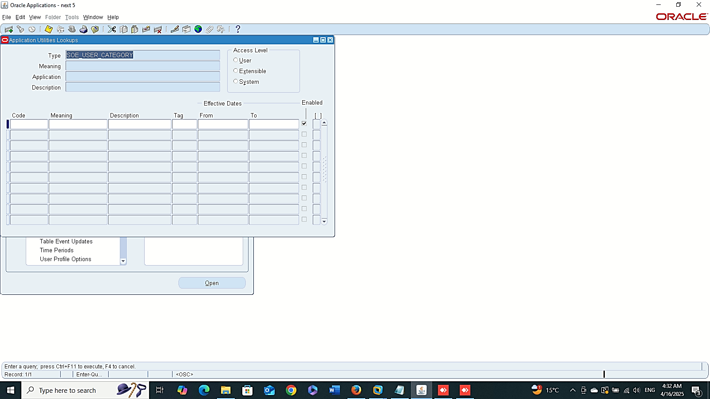
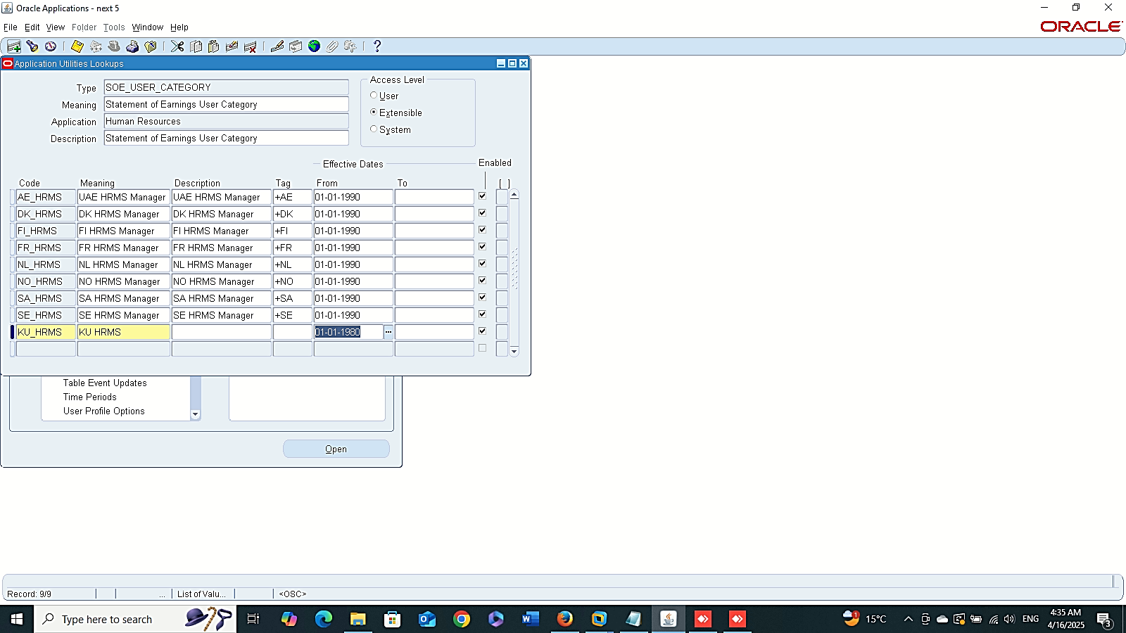
New User Category
Finance Management (Payroll)
SOE Setup
( Statement OF Earning):
SYSTEM ADMINISTRATOR > APPLICATION > MENU :
- Global HRMS Statement Of Earnings: to enable SOE from based
- Online Statement Of Earnings: to enable SOE web-based Function.
2- New User Category Code for Business Group:
GLOBAL HRMS MANAGER > OTHER DEFINITIONS > APPLICATION UTILITIES LOOKUPS

Slide 9
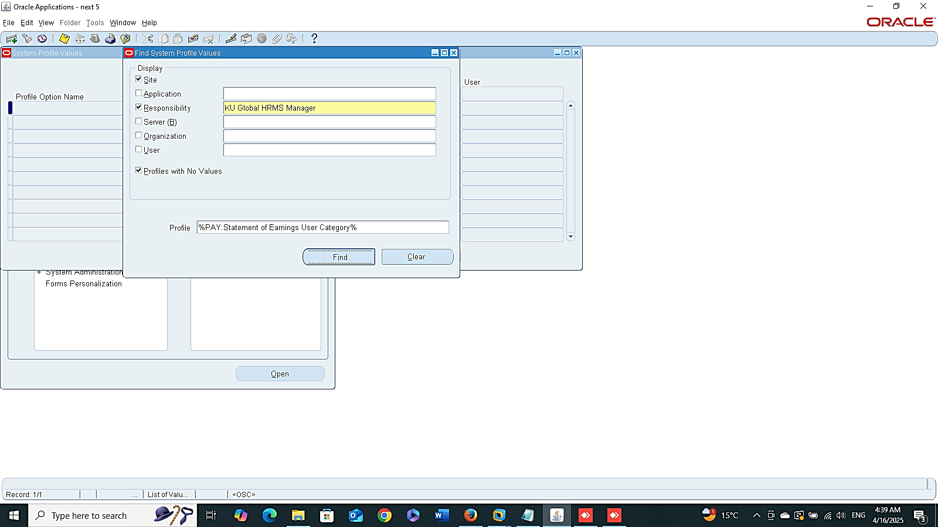
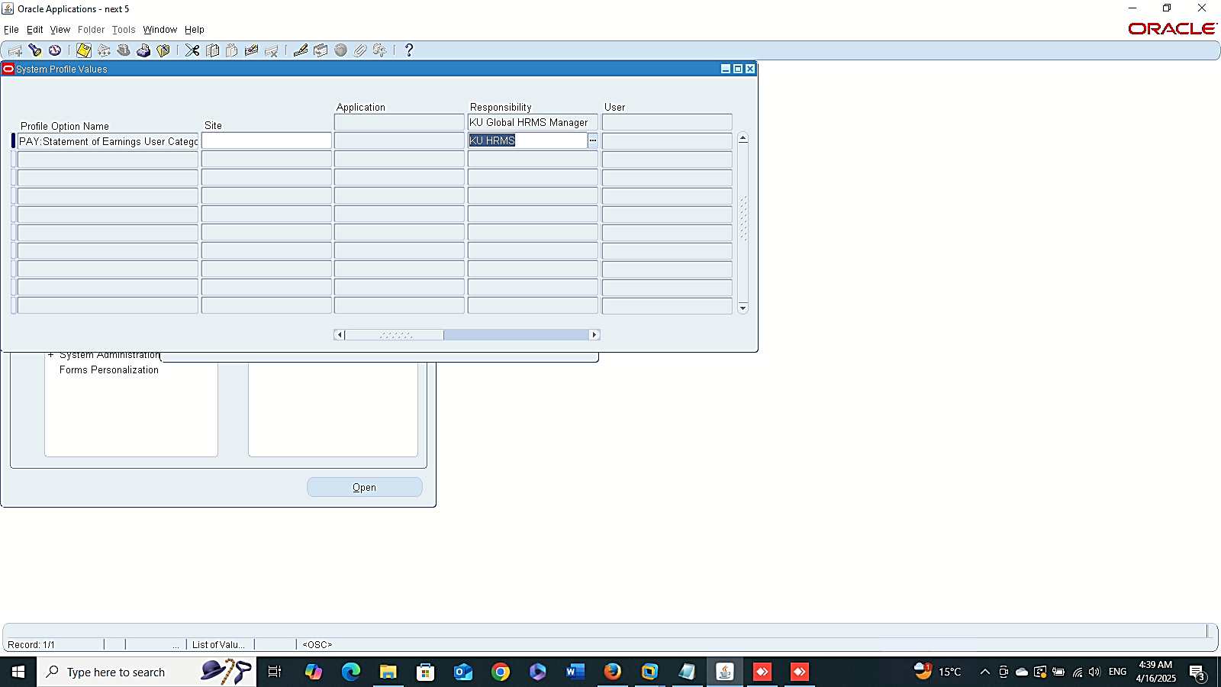
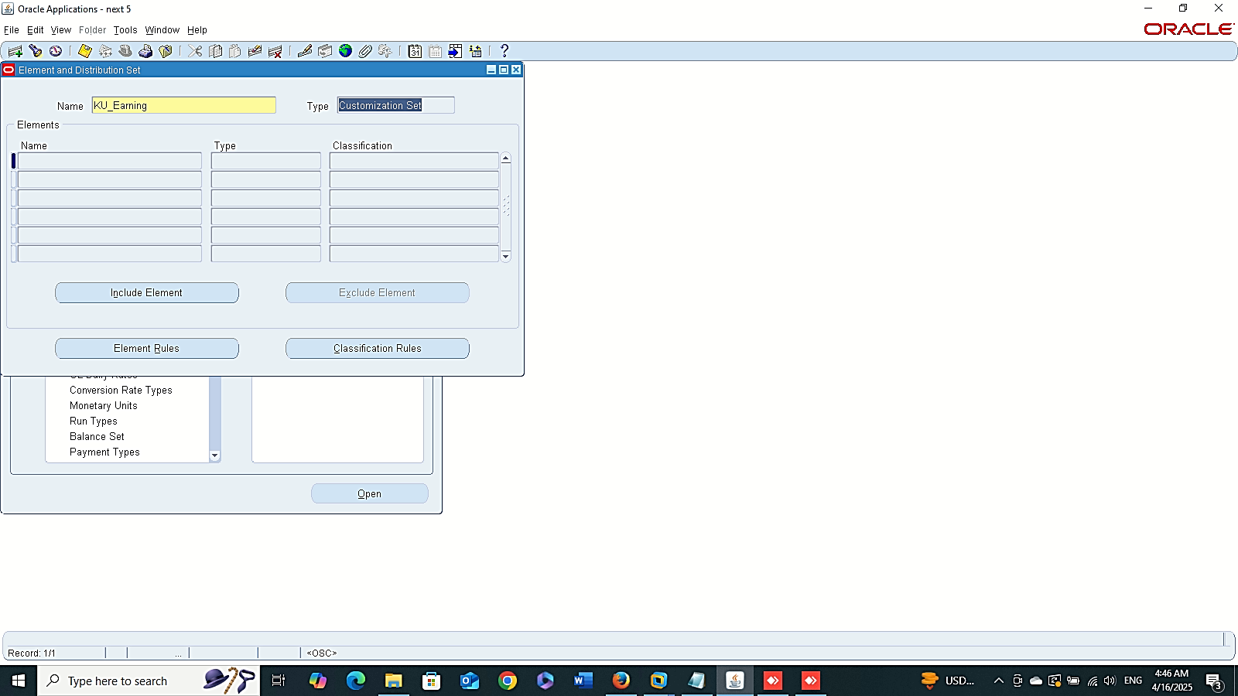
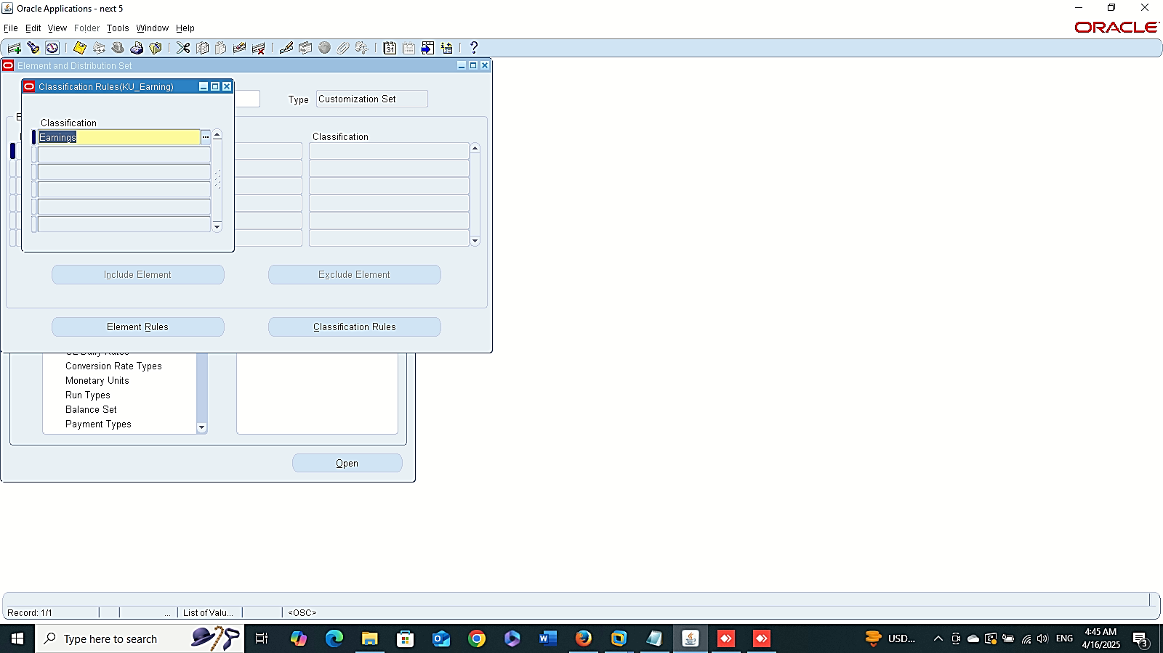
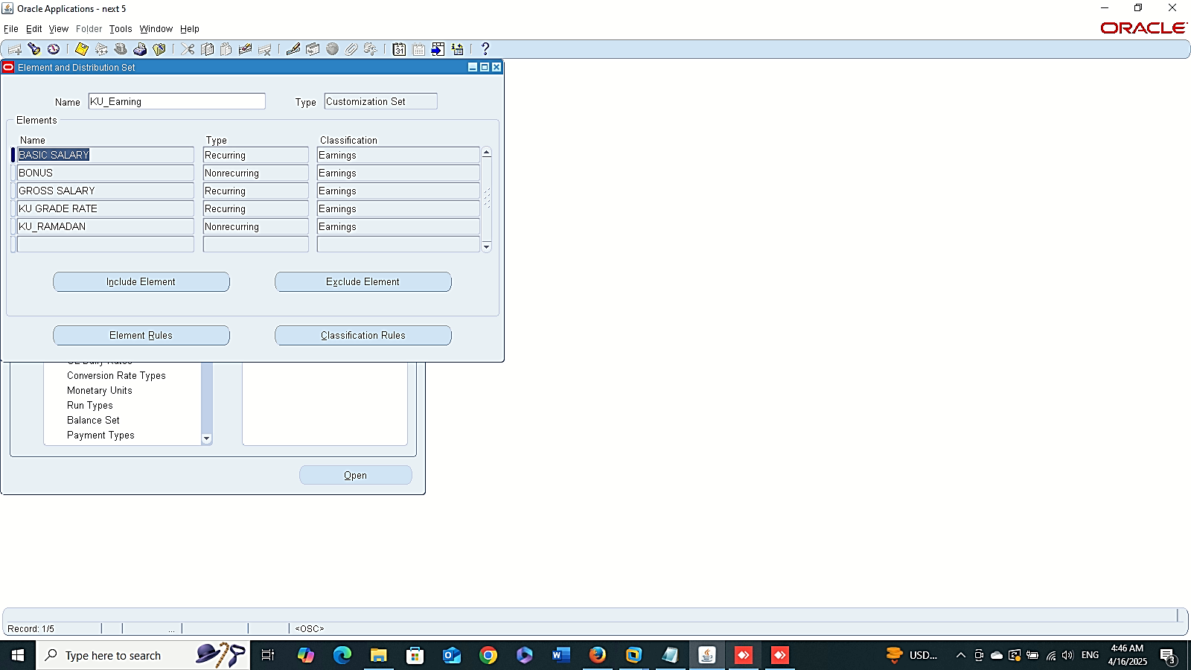
Finance Management (Payroll)
3- Link New User Category to Payroll or to site level:
SYSTEM ADMINISTTRATOR > PROFILE >SYSTEM
4- Create 3 Elements Sets:
GLOBAL HRMS MANAGER > PAYROLL > ELEMENT SET
A- EARNING
B-DEDUCTION
C- INFORMATION ELEMENT
Earning

Slide 10
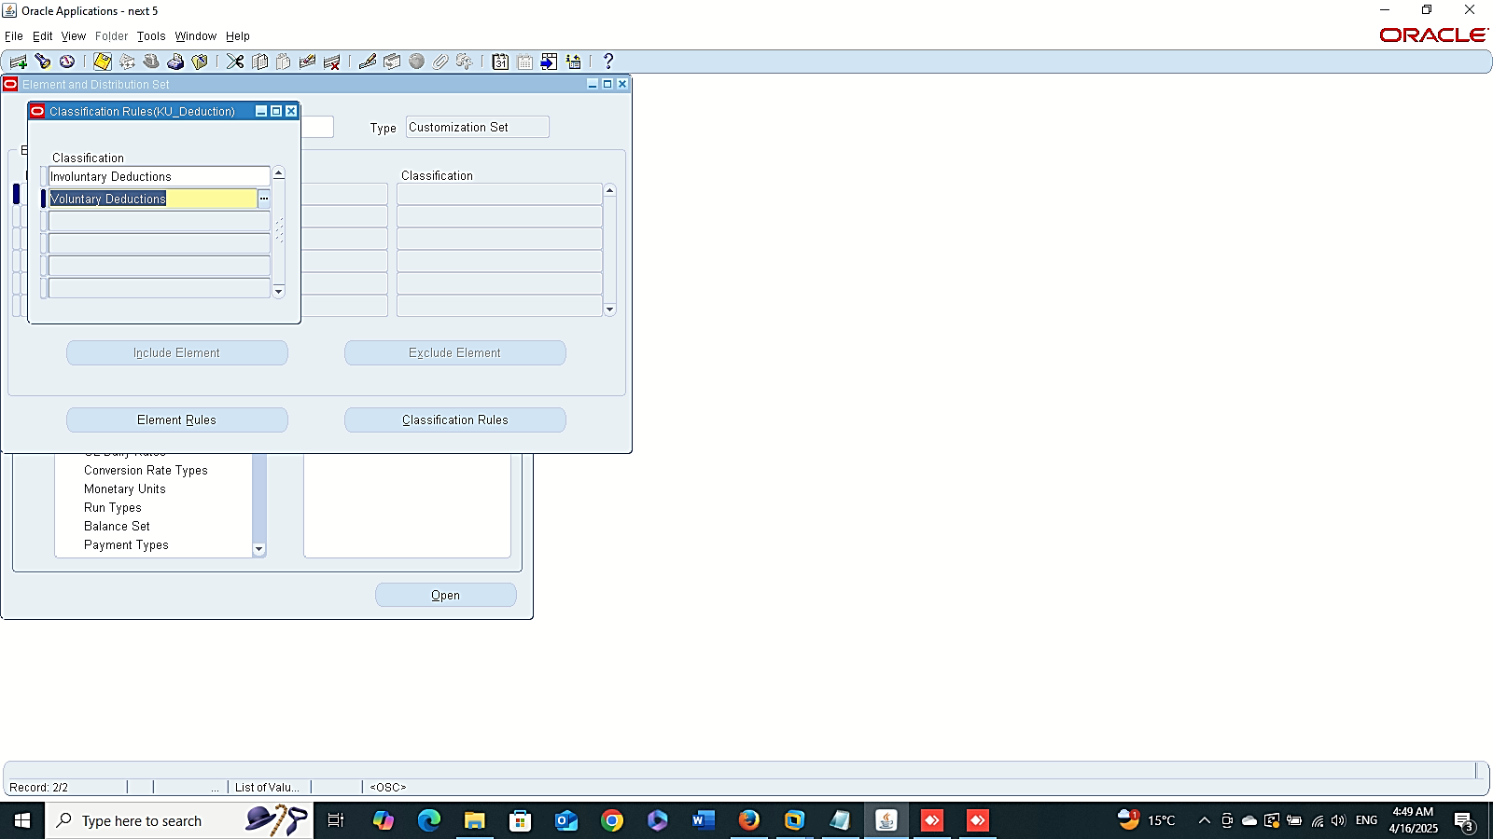
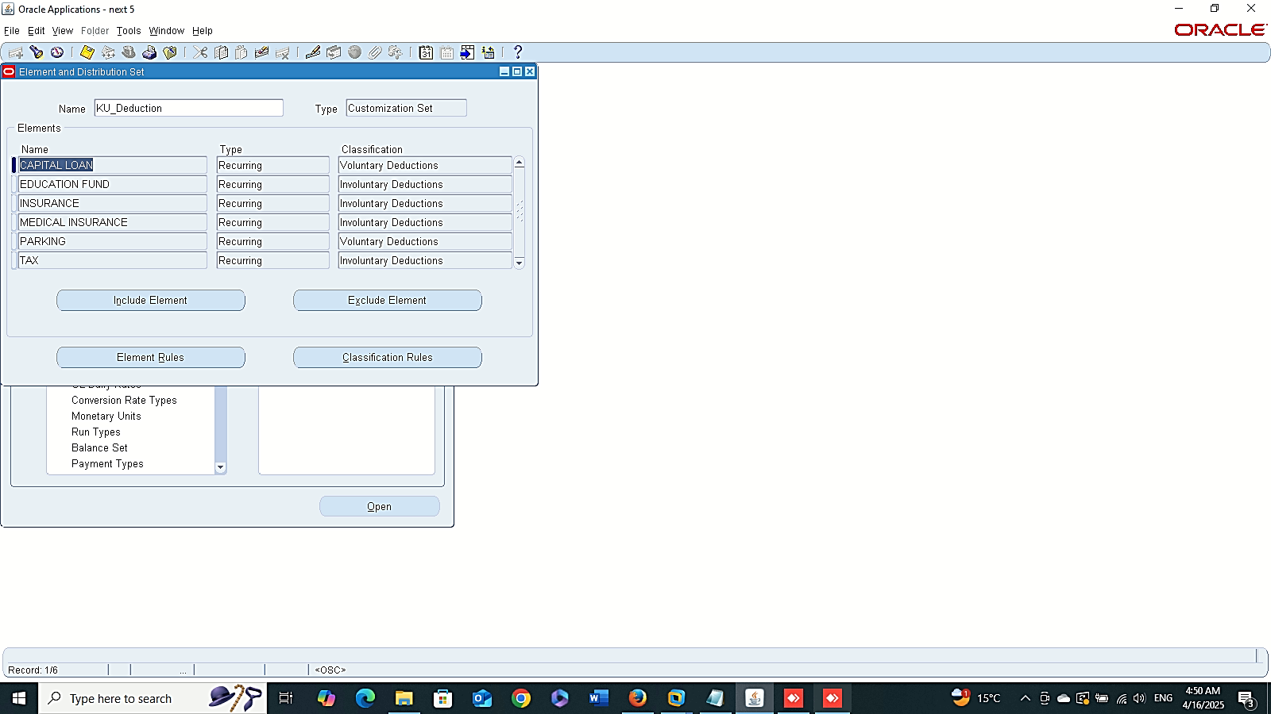


Deduction
Finance Management (Payroll)
4- Create 3 Elements Sets:
GLOBAL HRMS MANAGER > PAYROLL > ELEMENT SET
A- EARNING
B-DEDUCTION
C- INFORMATION ELEMENT
Information

Slide 11
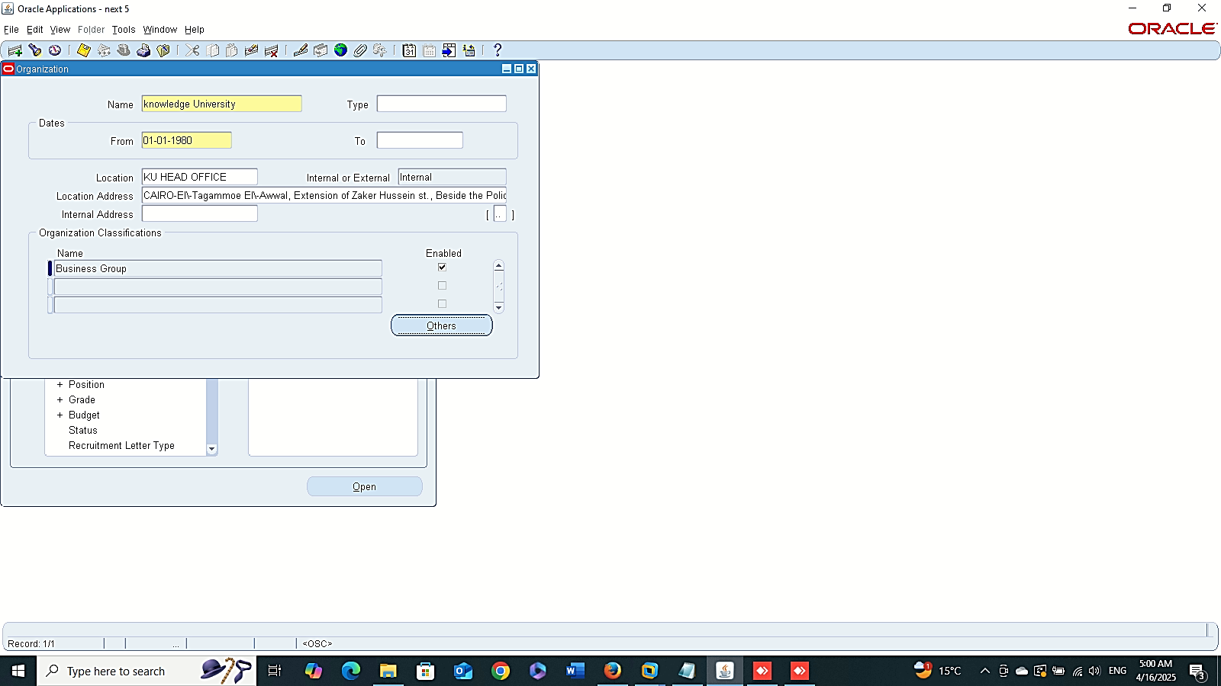
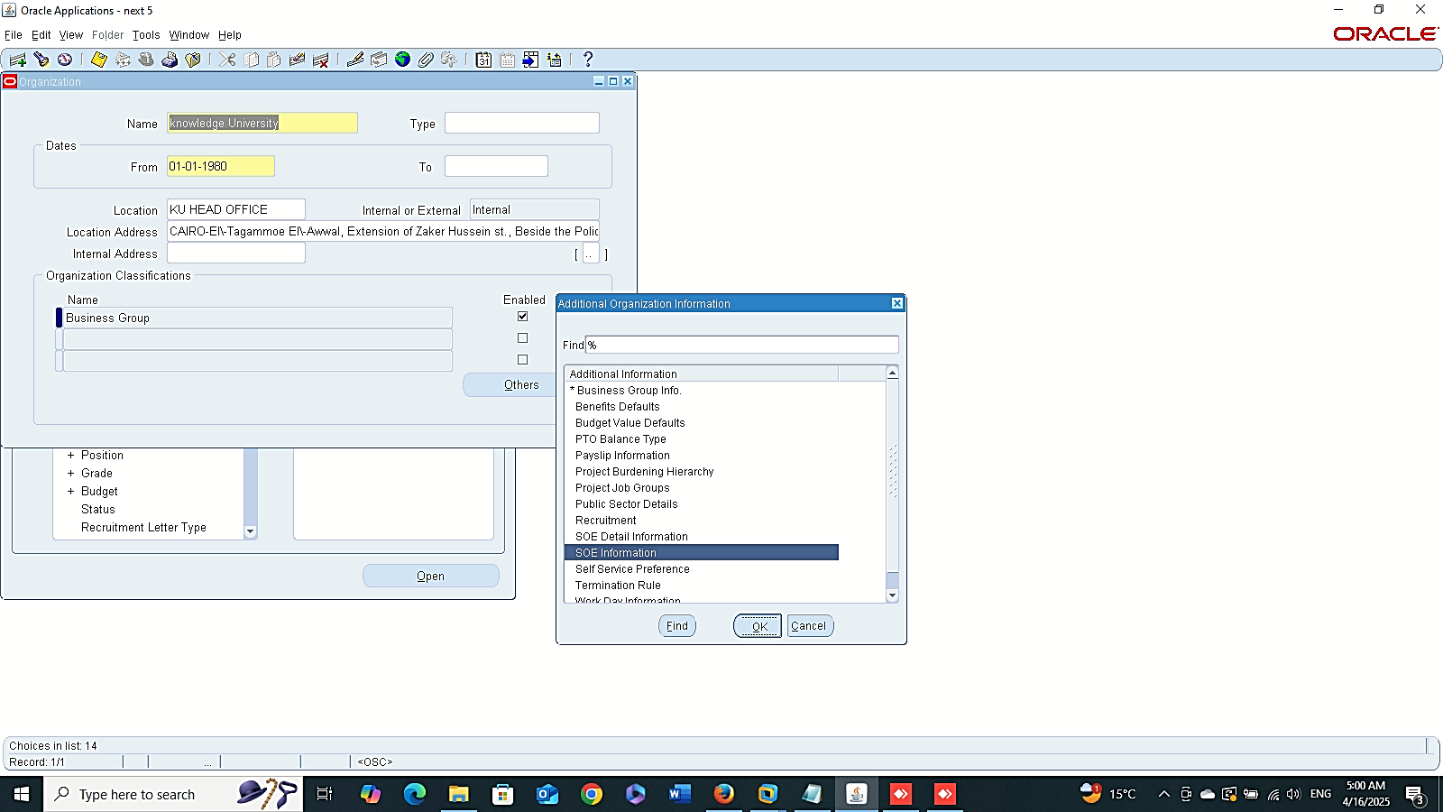
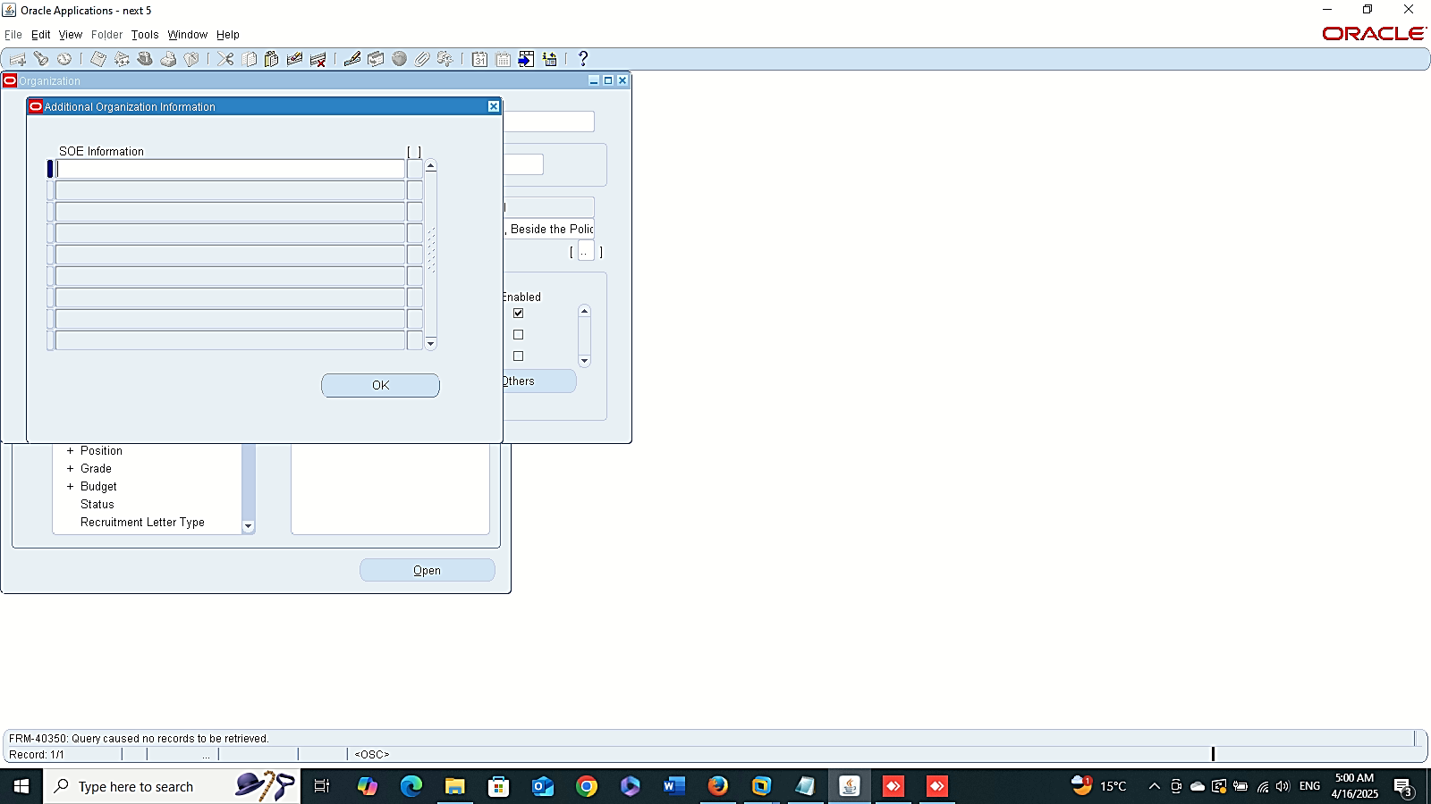
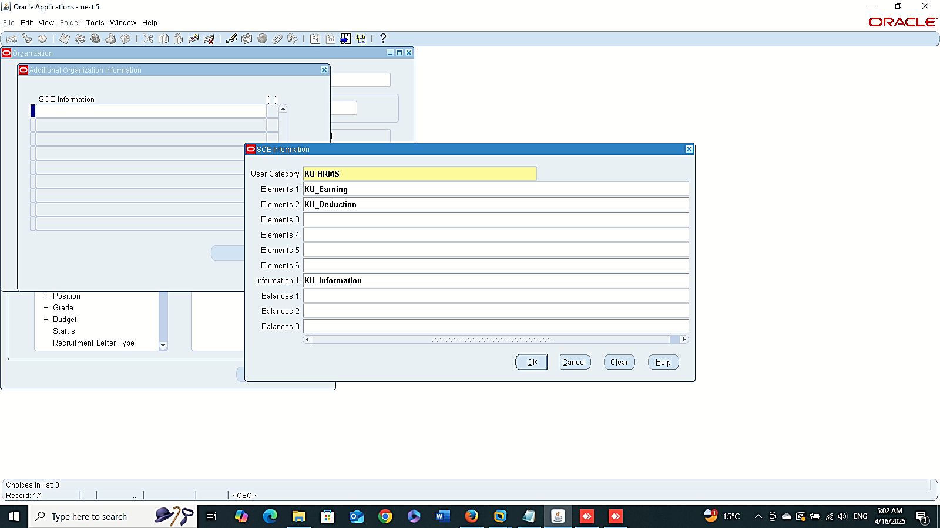
Other
Finance Management (Payroll)
4- Enter Data in BG:
GLOBAL HRMS MANAGER > WORK STRUCTURE > ORGANIZATION > DESCRIPTION

Slide 12
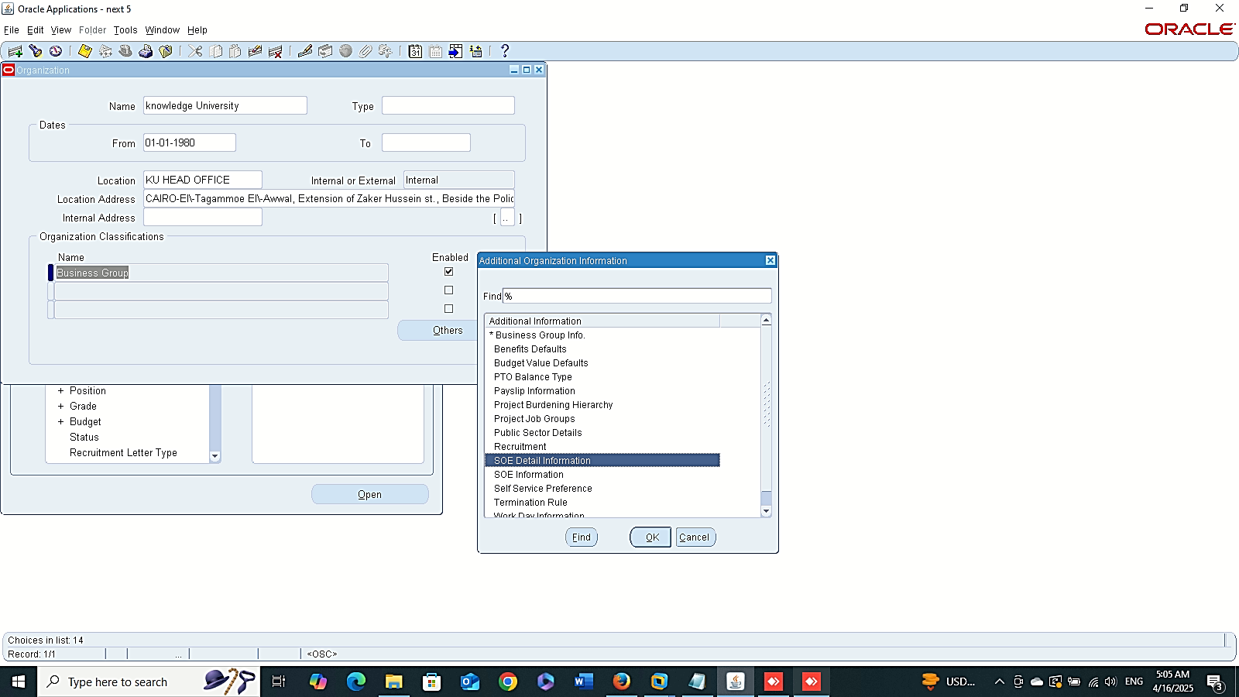
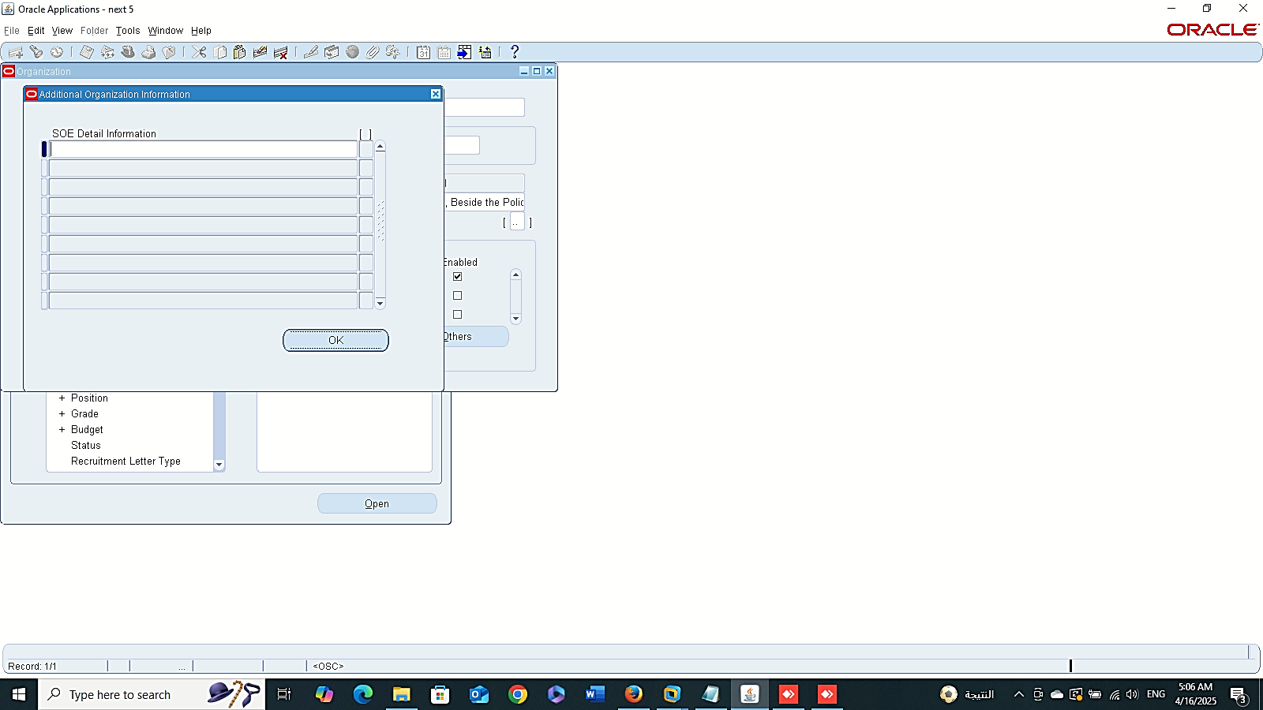
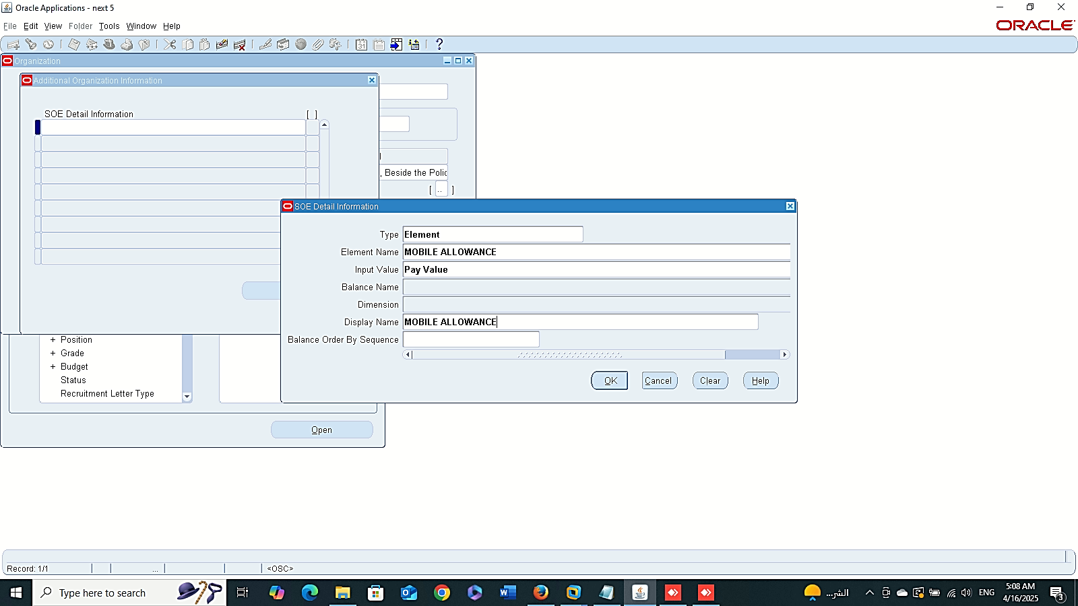
Finance Management (Payroll)
4- Enter Data in BG:
GLOBAL HRMS MANAGER > WORK STRUCTURE > ORGANIZATION > DESCRIPTION
OTHER

Slide 13
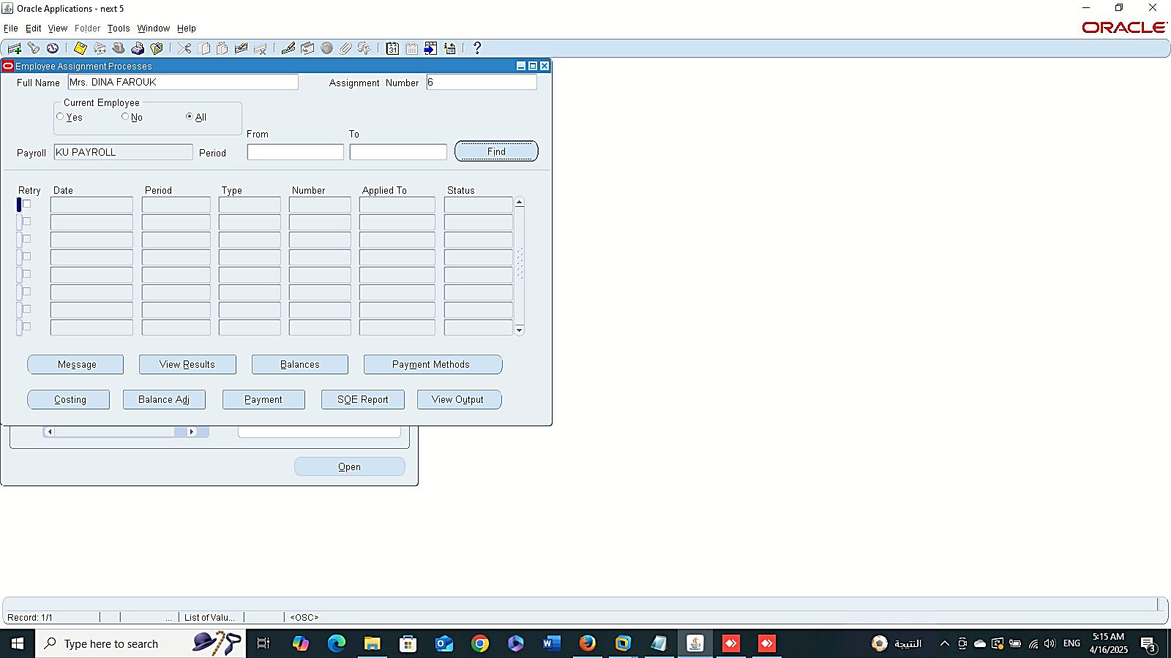
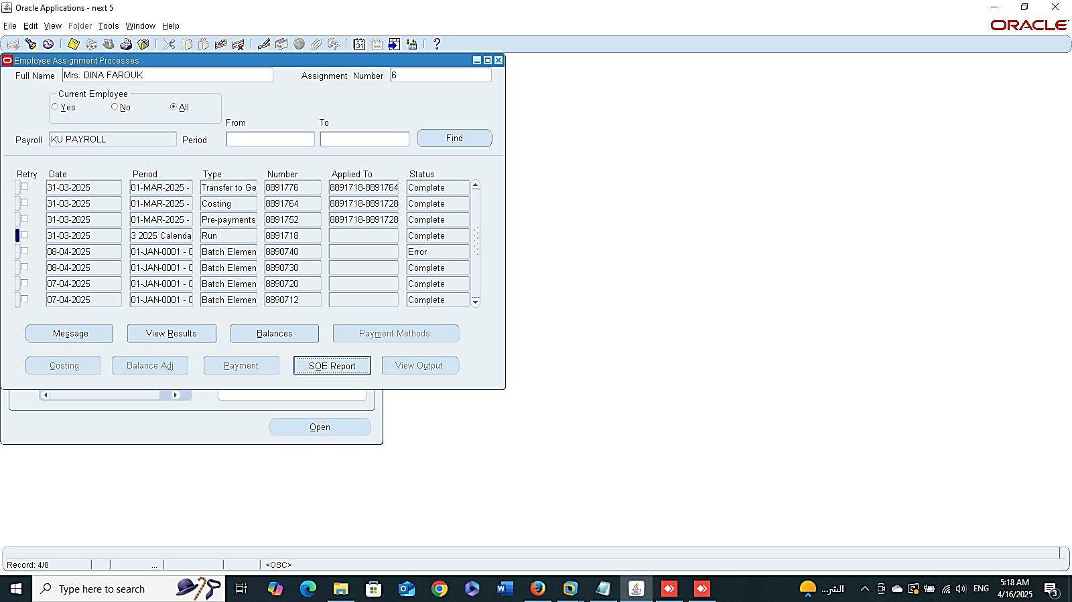
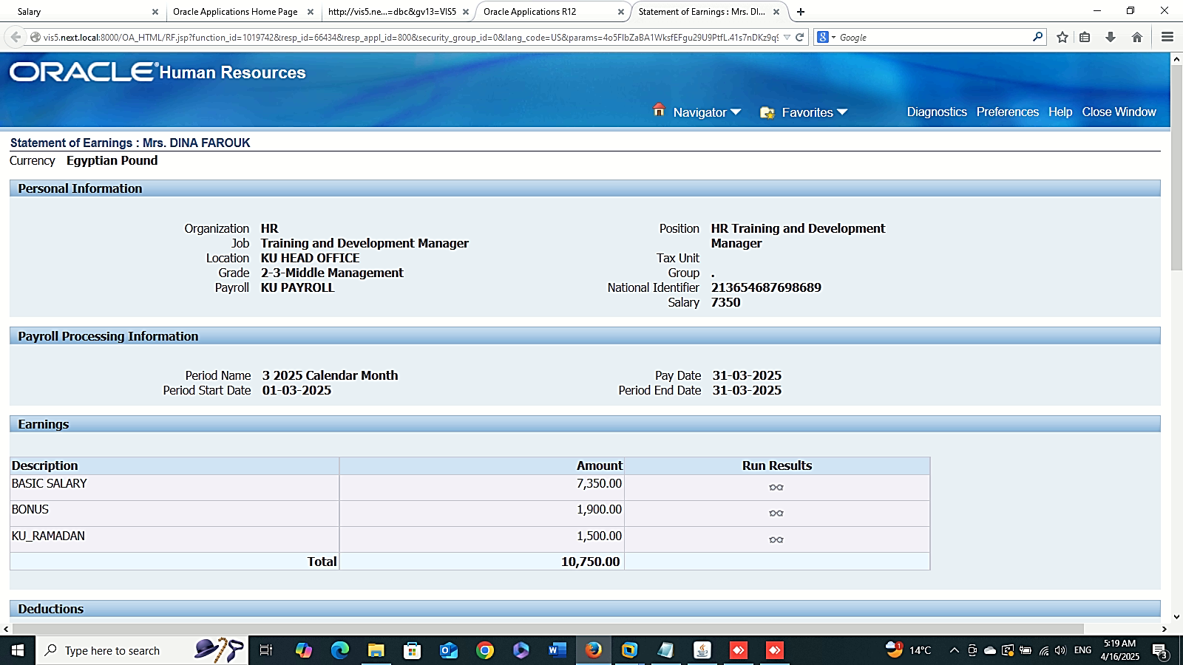
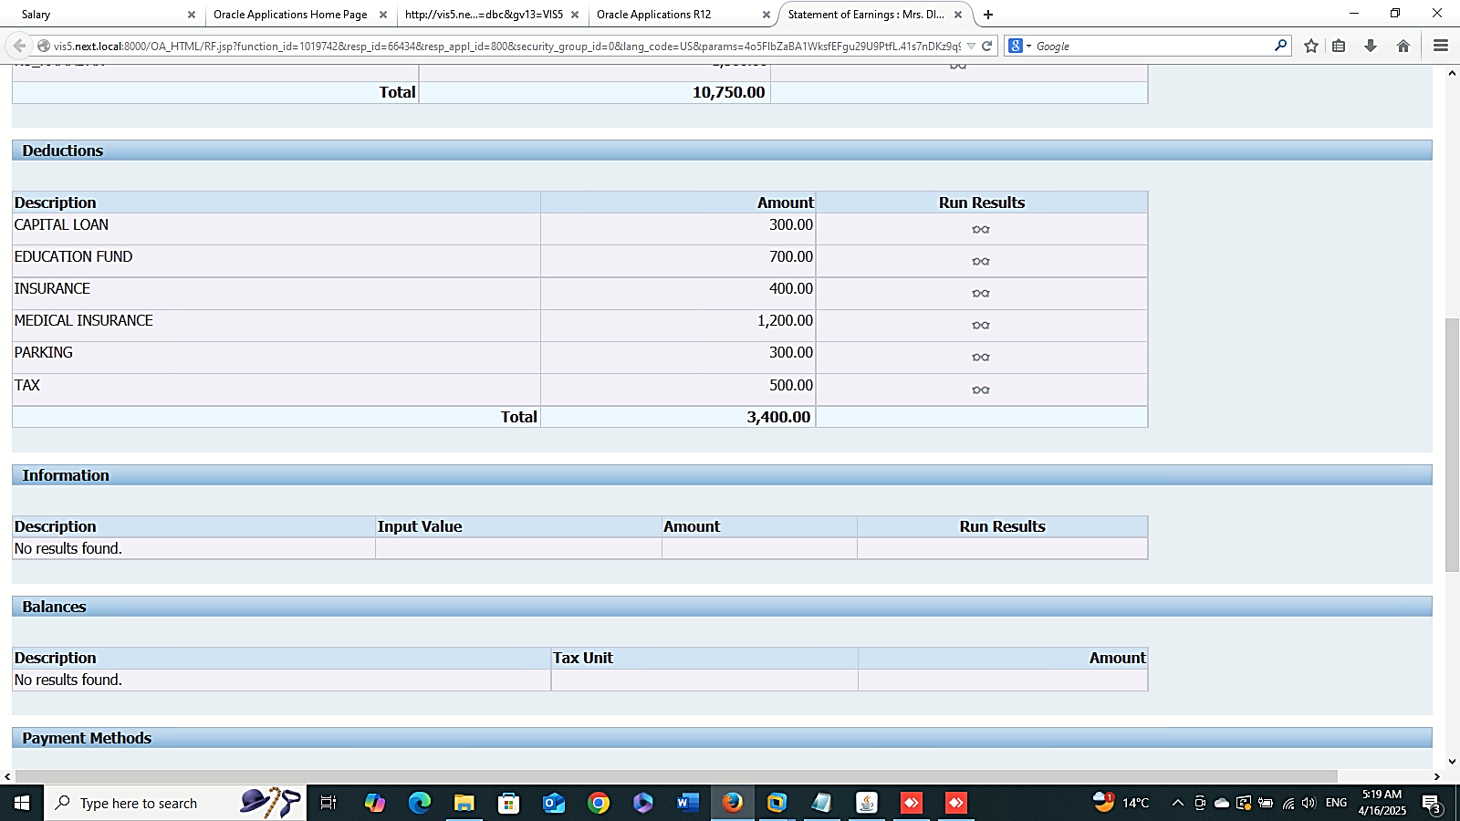
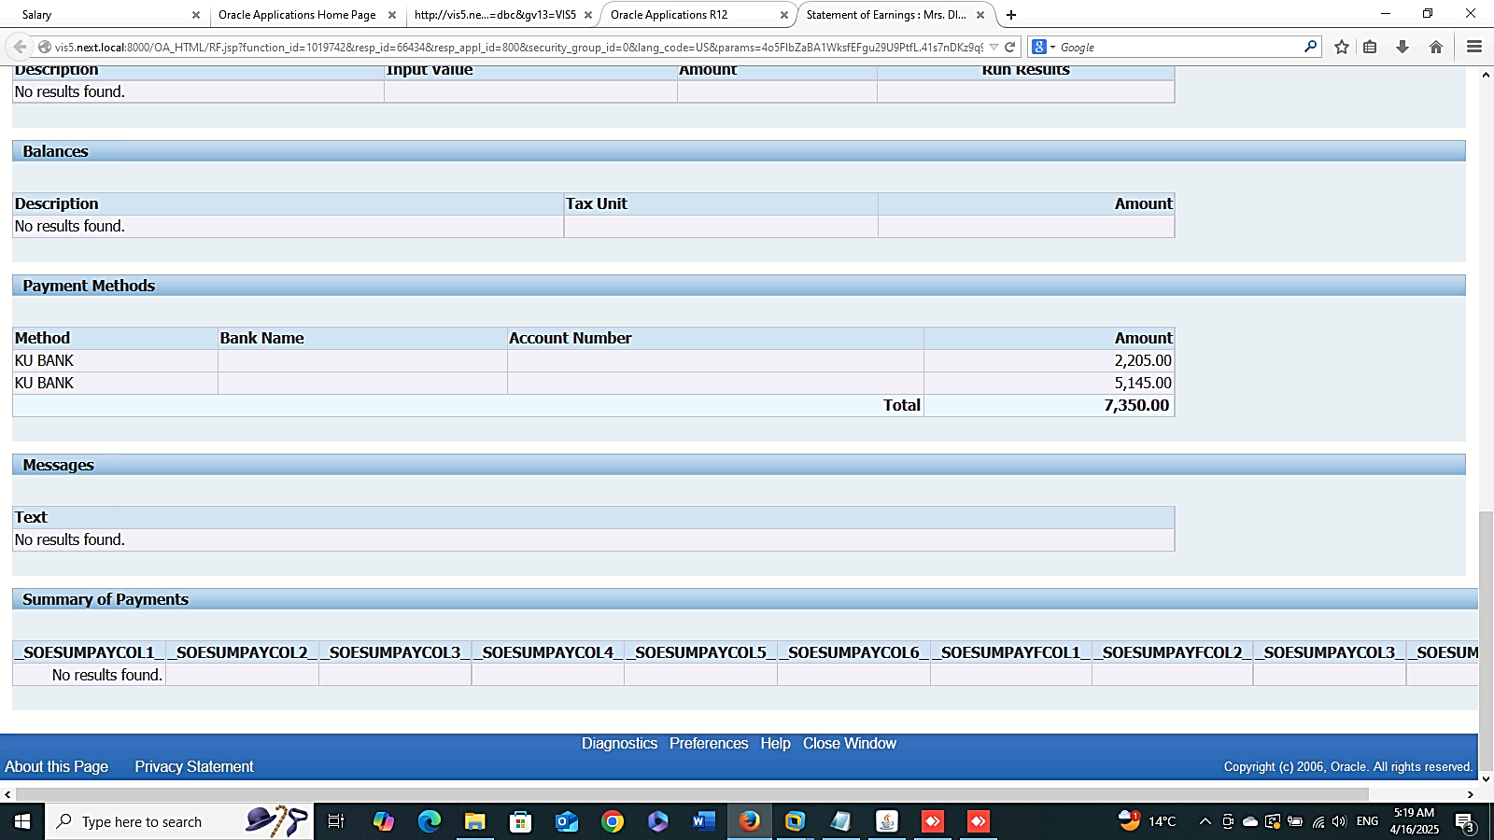
Finance Management (Payroll)
Assignment Process Results:
GLOBAL HRMS MANAGER > VIEW > LISTS > ASSIGNMENT PROCESS RESULTS
SOE Report

Slide 14

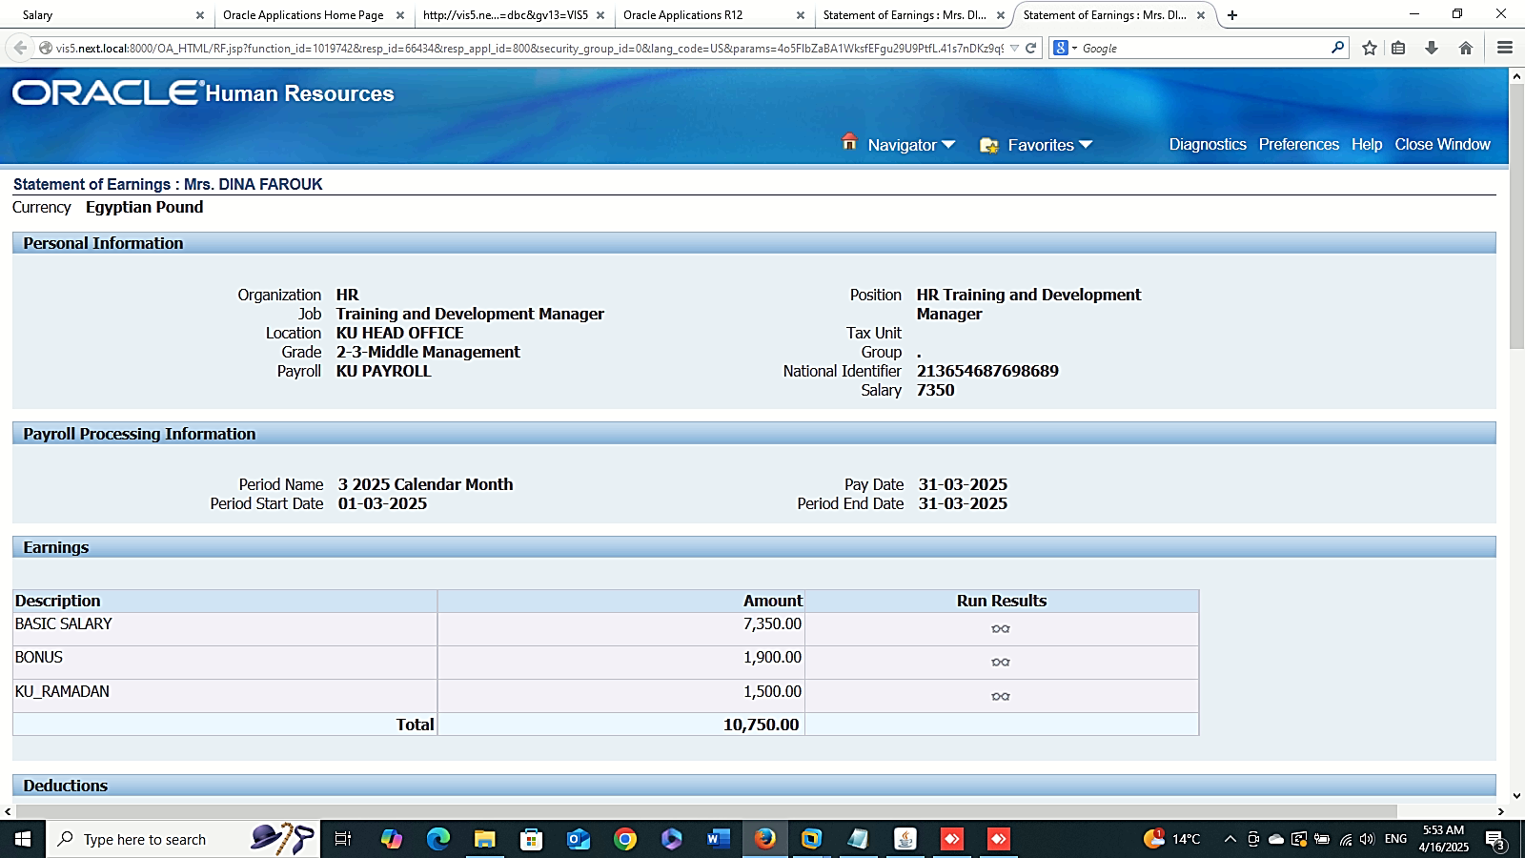
Finance Management (Payroll)
Payroll Process Results:
GLOBAL HRMS MANAGER > VIEW > LISTS > PAYROLL PROCESS RESULTS > ASSIGNMENT PROCESS

Slide 15
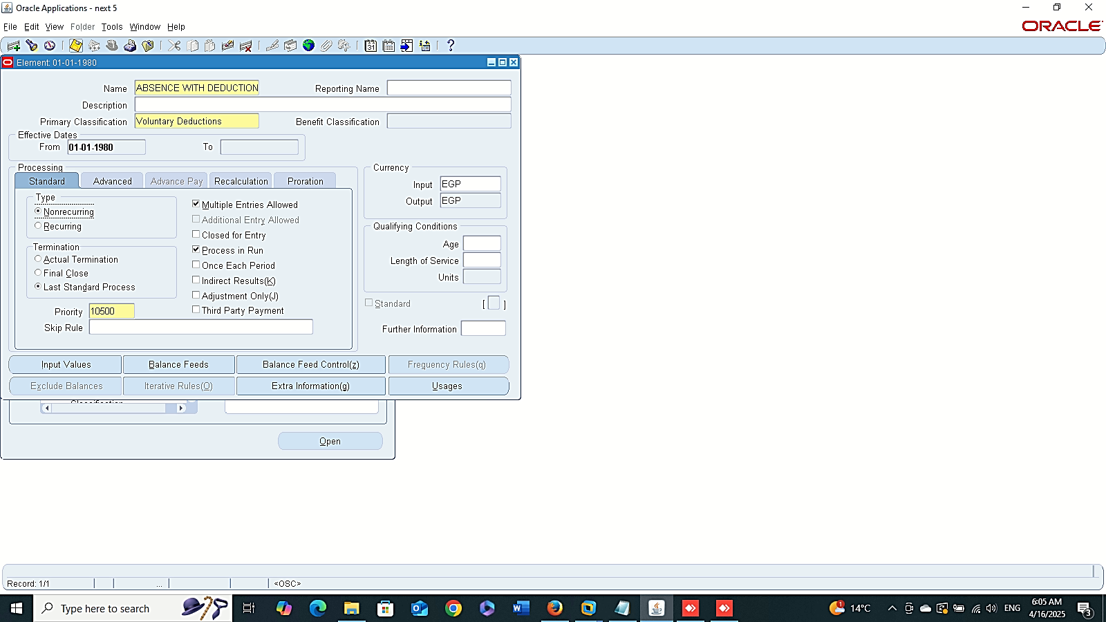
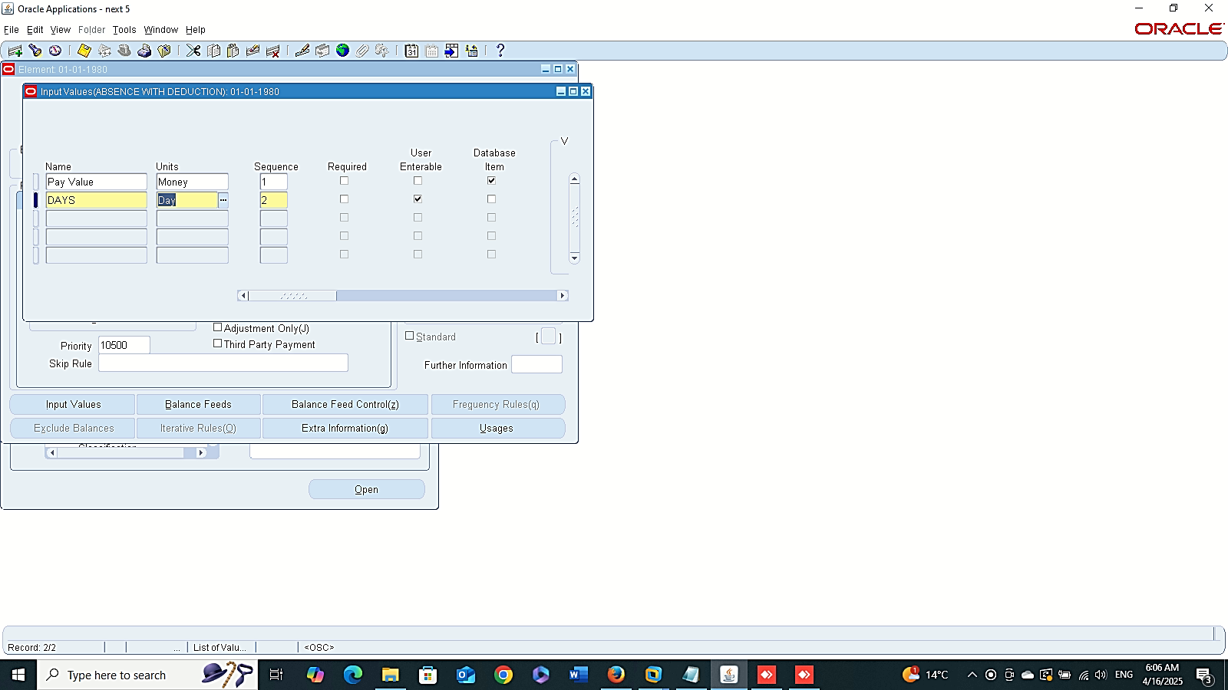
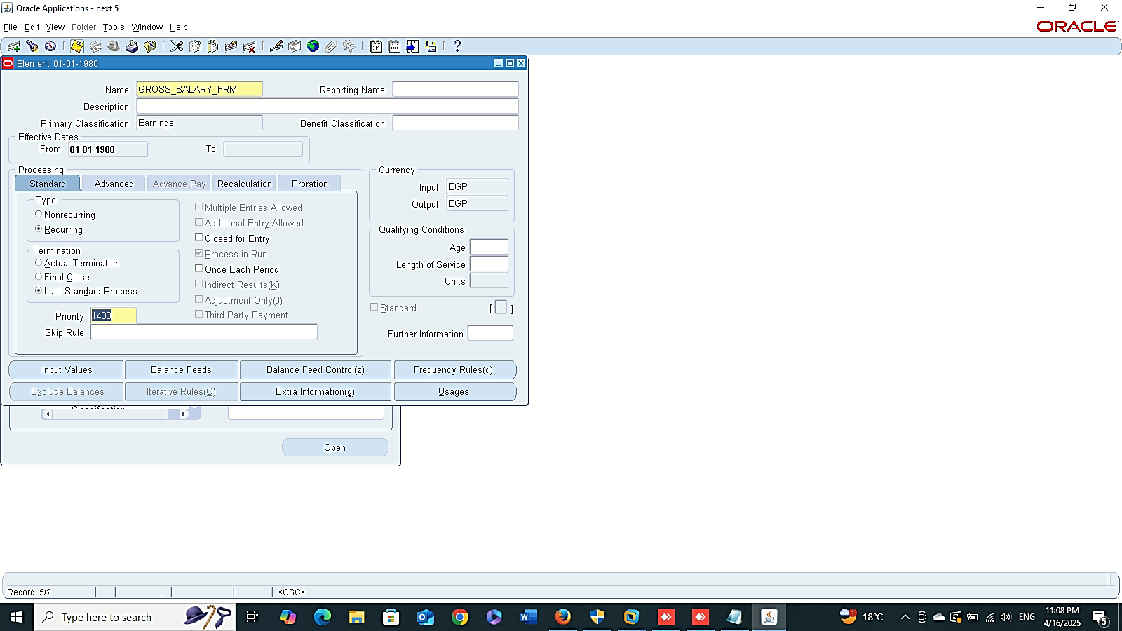
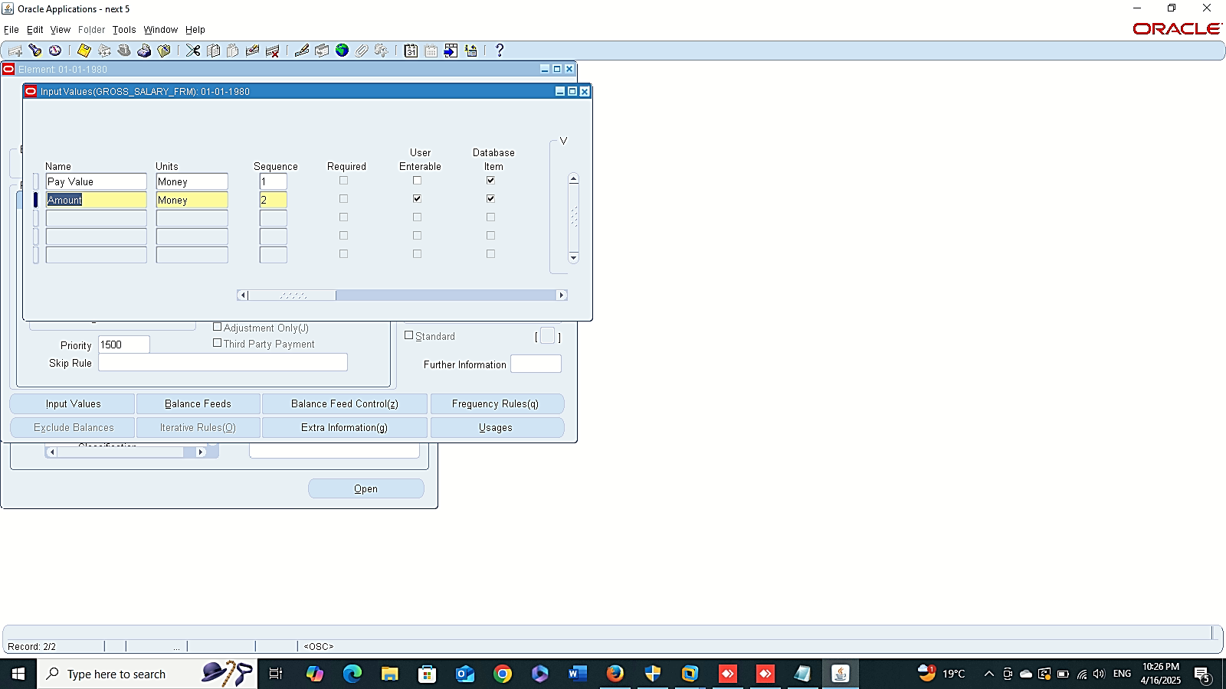
Absence With Deduction
Finance Management (Payroll)
Absence Management :
“Payroll Officer”
1- Create New Element
GLOBAL HRMS MANAGER > TOTAL COMPENSATION > BASIC > ELEMENT
Gross Salary

Slide 16
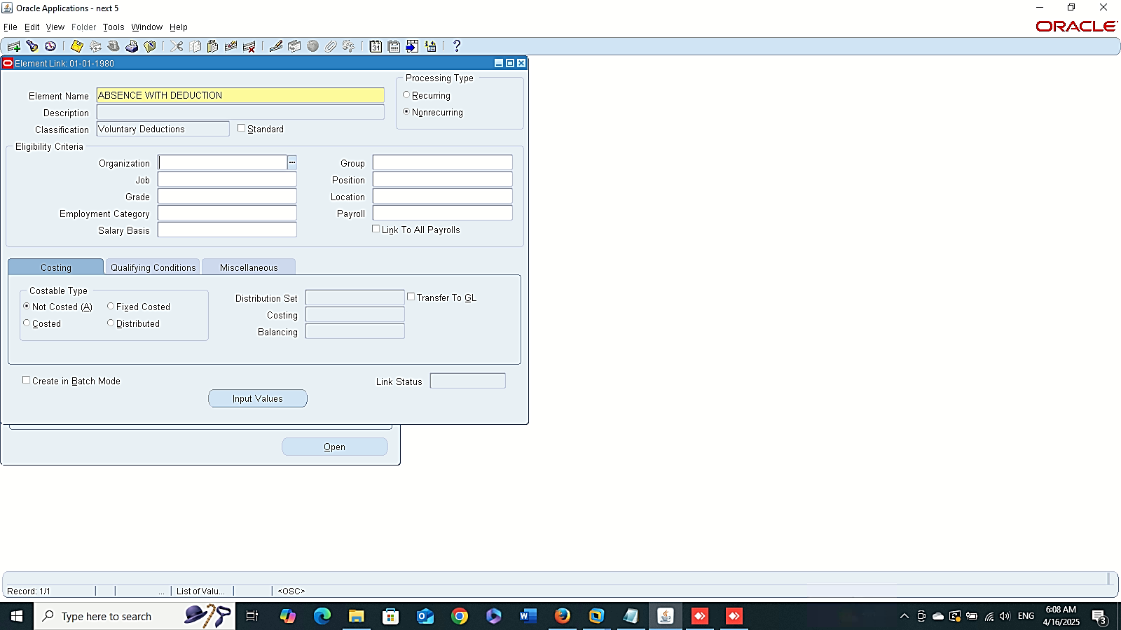
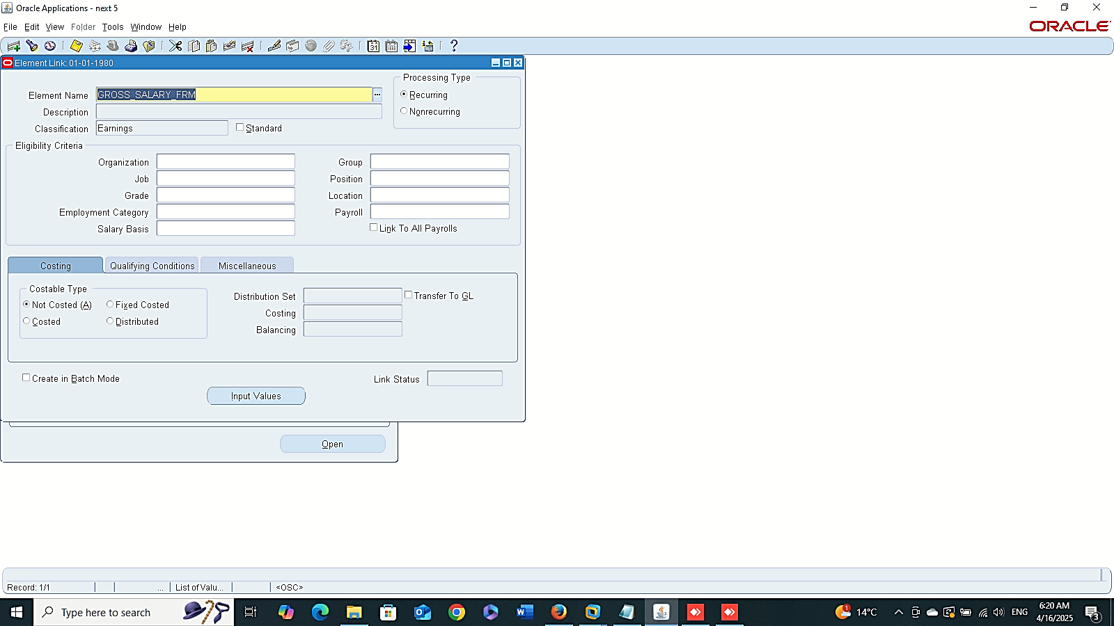
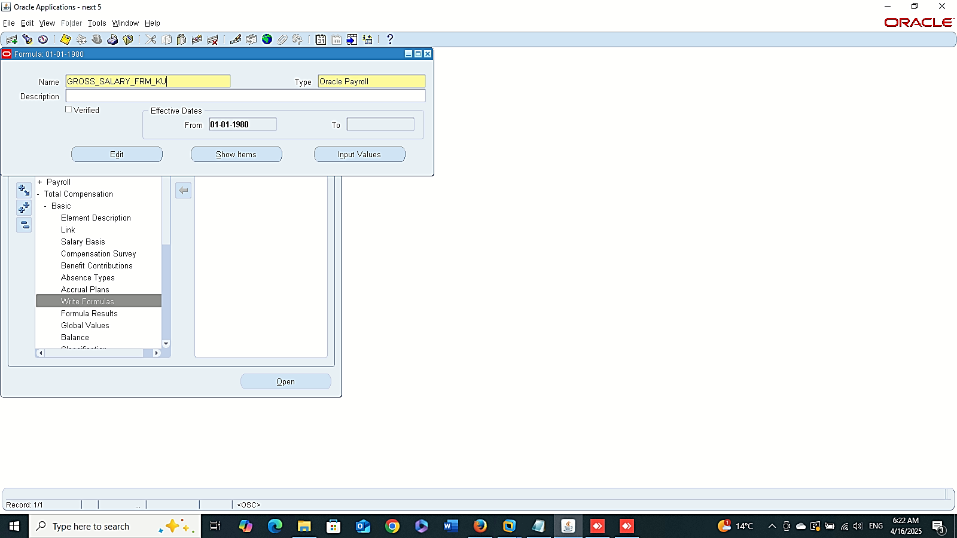
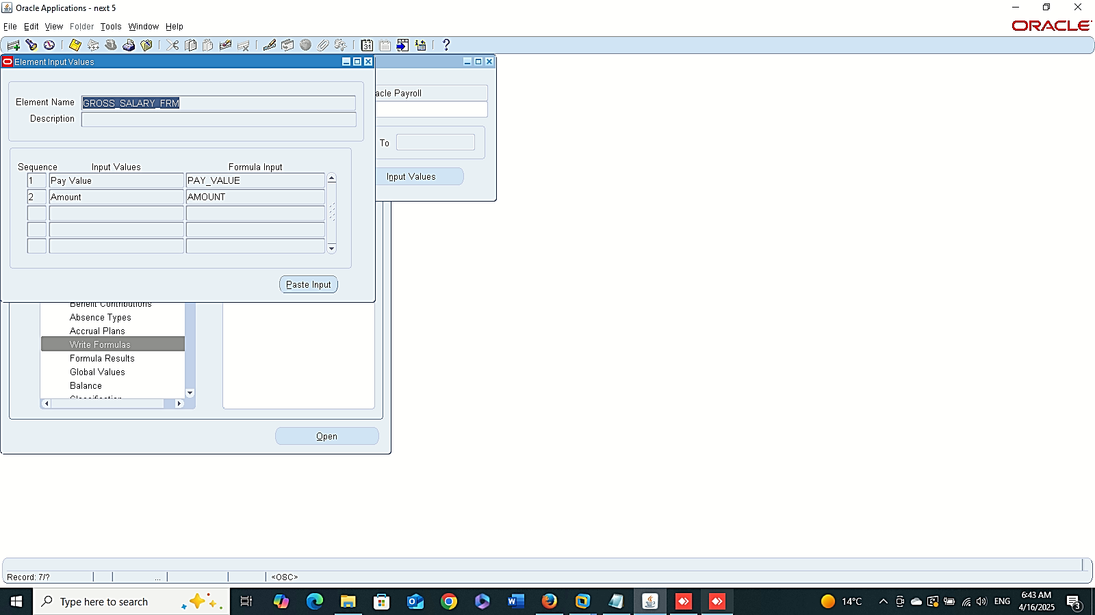
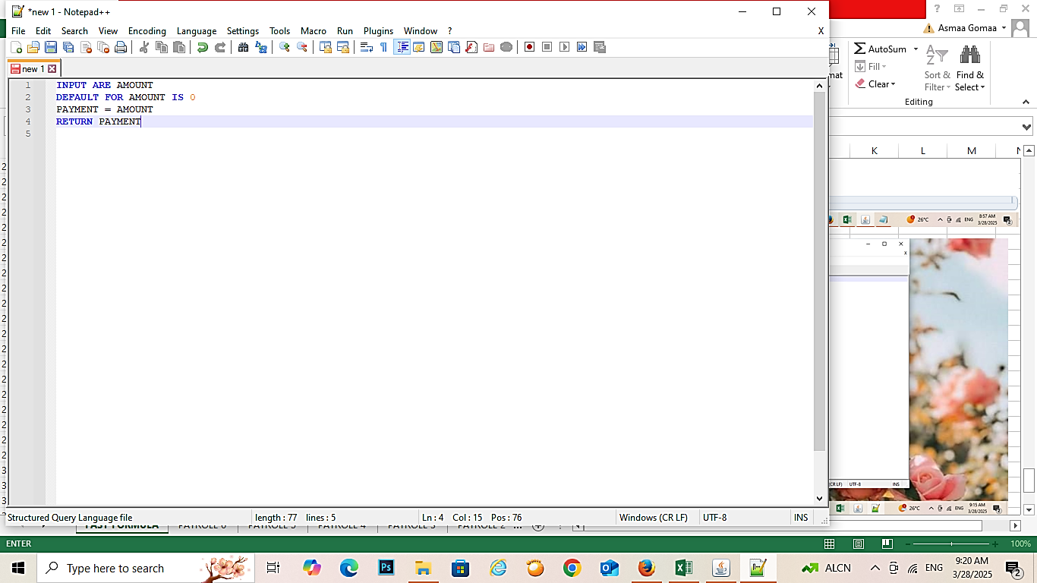
Create Link
Finance Management (Payroll)
Absence Management :
“Payroll Officer”
2- Create New Link
GLOBAL HRMS MANAGER > TOTAL COMPENSATION > BASIC > LINK
3- Write Formula
GLOBAL HRMS MANAGER > TOTAL COMPENSATION > BASIC > WRITE FORMULA
Write Formula
Input Values

Slide 17




Finance Management (Payroll)
Absence Management :
“Payroll Officer”
--- Edit

Slide 18




Finance Management (Payroll)
Absence Management :
“Payroll Officer”
--- Show Items
GROSS_SALARY_FRM_AMOUNT_ENTRY_VALUE

Slide 19





Formula Results
Finance Management (Payroll)
Absence Management :
“Payroll Officer”
4 - Formula Results
GLOBAL HRMS MANAGER > TOTAL COMPENSATION > BASIC > FORMULA RESULTS
5 – Add Elements Entries For People
GLOBAL HRMS MANAGER > PEOPLE > ENTER AND MAINTAIN > FIND > ASSIGNMENT > ENTRIES
Add Element Entries

Slide 20




Finance Management (Payroll)
Absence Management :
“Payroll Officer”
6 – Quick Pay
GLOBAL HRMS MANAGER > PEOPLE > ENTER AND MAINTAIN > FIND > ASSIGNMENT > OTHER > QUICKPAY

